Slide 1
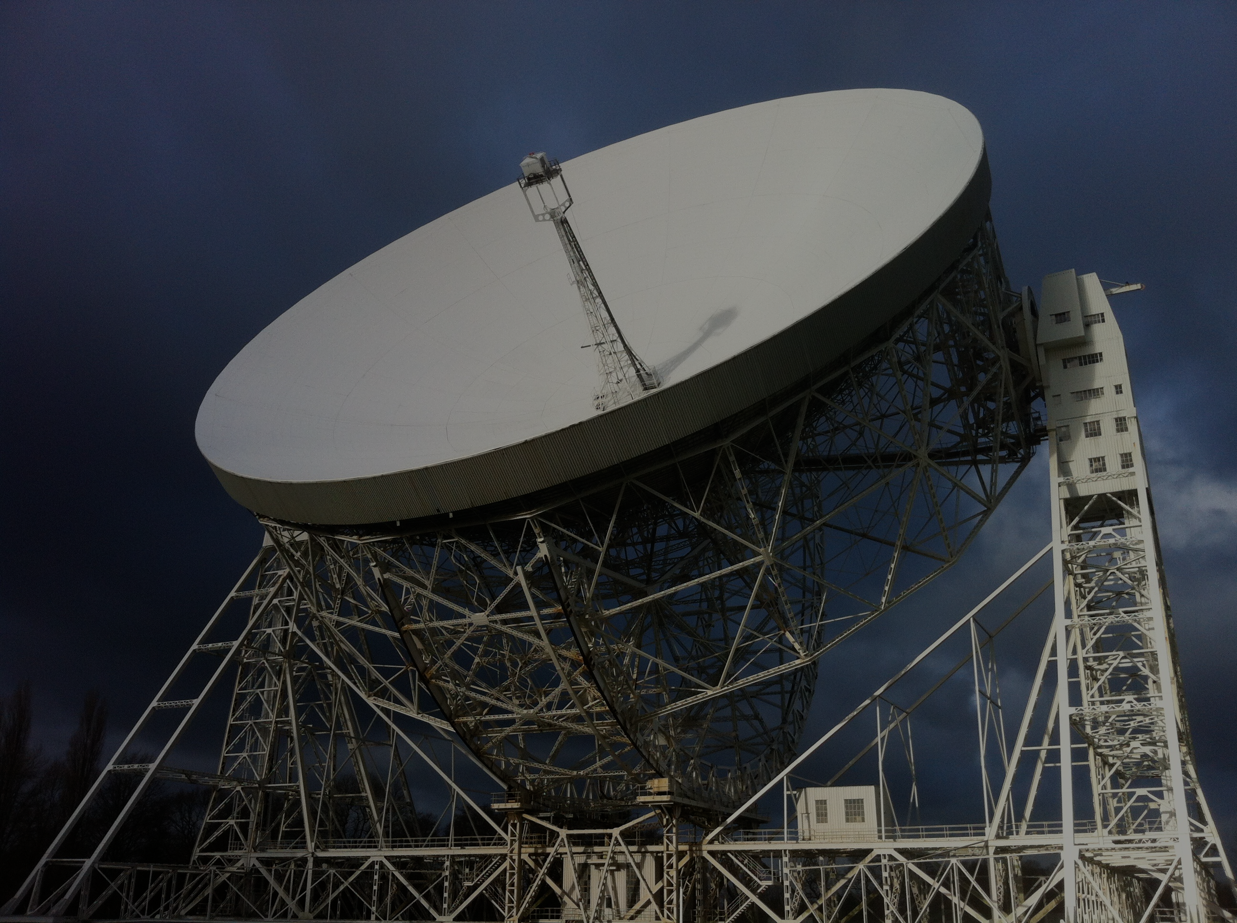
A.I. for Astrophysics: Masterclass
Dr. Rob Lyon
Edge Hill University
robert.lyon@edgehill.ac.uk
Notes:
keyword colour: FFA43D
Classes & objects: 98C2DC
Variables and literals: 99BEFF
Comments: EBEBEB
Variable names (yellow): F2F200
Methods: 50E272
Slide background colour: #1A1B20
Slide title: #F5C343 (gold)
Slide text: #FAE7A3 (yellow)
Slide text: #FFA43D (orange)

Slide 2
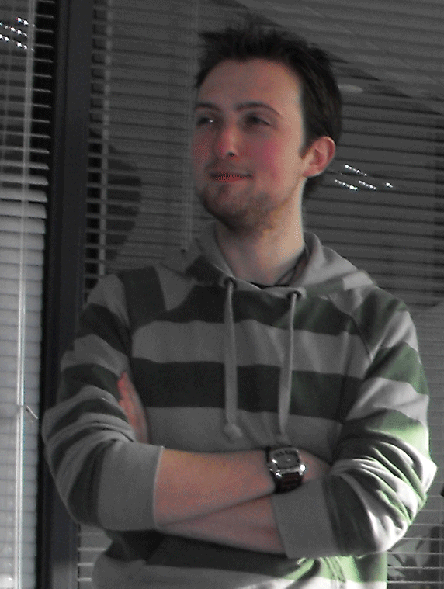
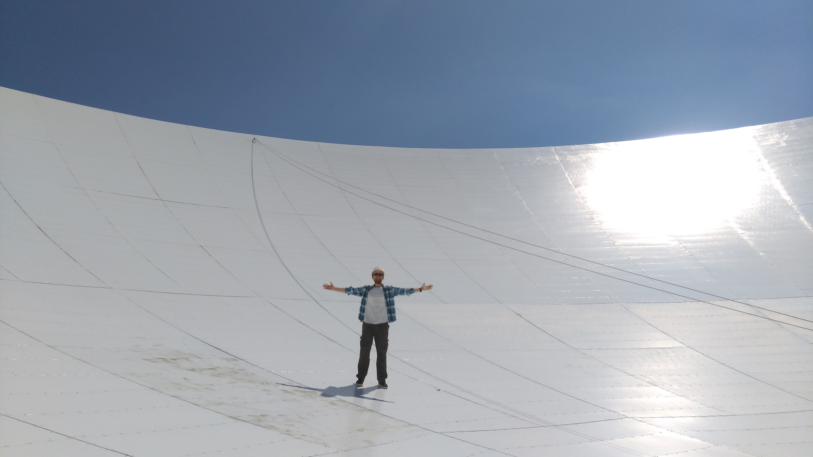
Welcome
Welcome to the masterclass!
During the next hour I aim to introduce the fascinating area of research that I work in.
I aim to teach you a little about this area, but more importantly, to show you that computer science careers aren’t just limited to programming jobs.
As computer scientists, we have skills needed in many domains – medicine, physics, chemistry and even astronomy!
If you work hard, you can succeed in any of these fields - if your determined!
If I can do it – so can you!!
Young Rob, age 22,
Software Engineer.
Young Rob, age 26,
Astronomer & ML researcher.

Slide 3
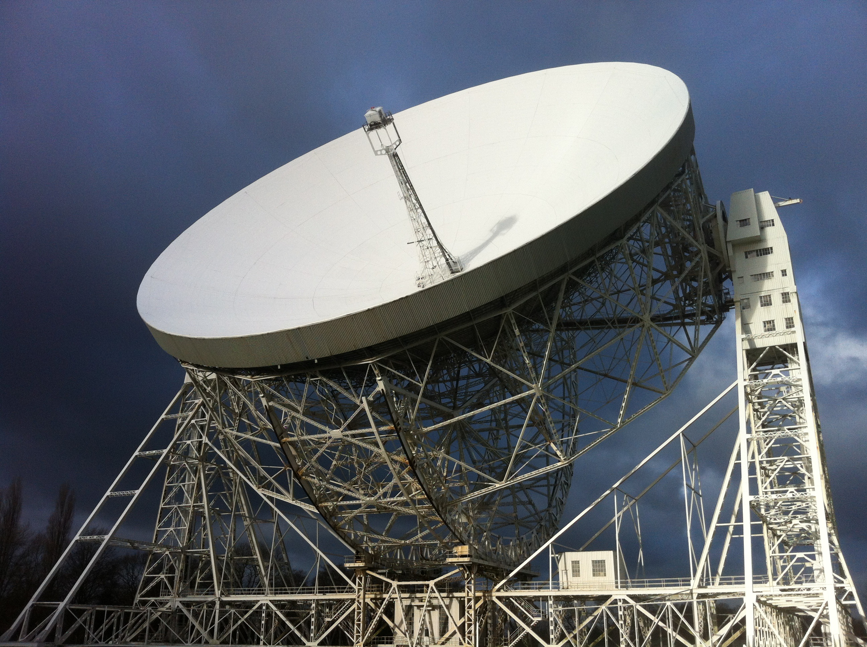
Radio Telescopes are big….

Slide 4
Masterclass Structure
Structure of the masterclass:
First I introduce you to the world of astronomy – and the search for radio pulsars (~15 mins).
Then we talk about why computer science, and the tools of machine learning in particular, are so crucial to the search (~15 mins)
After this I talk you through the basics of machine learning (~15 mins).
Finally, I provide you with some resources that allow you to search for pulsars using machine learning (15 mins)
Time for any questions you may have!

Slide 5
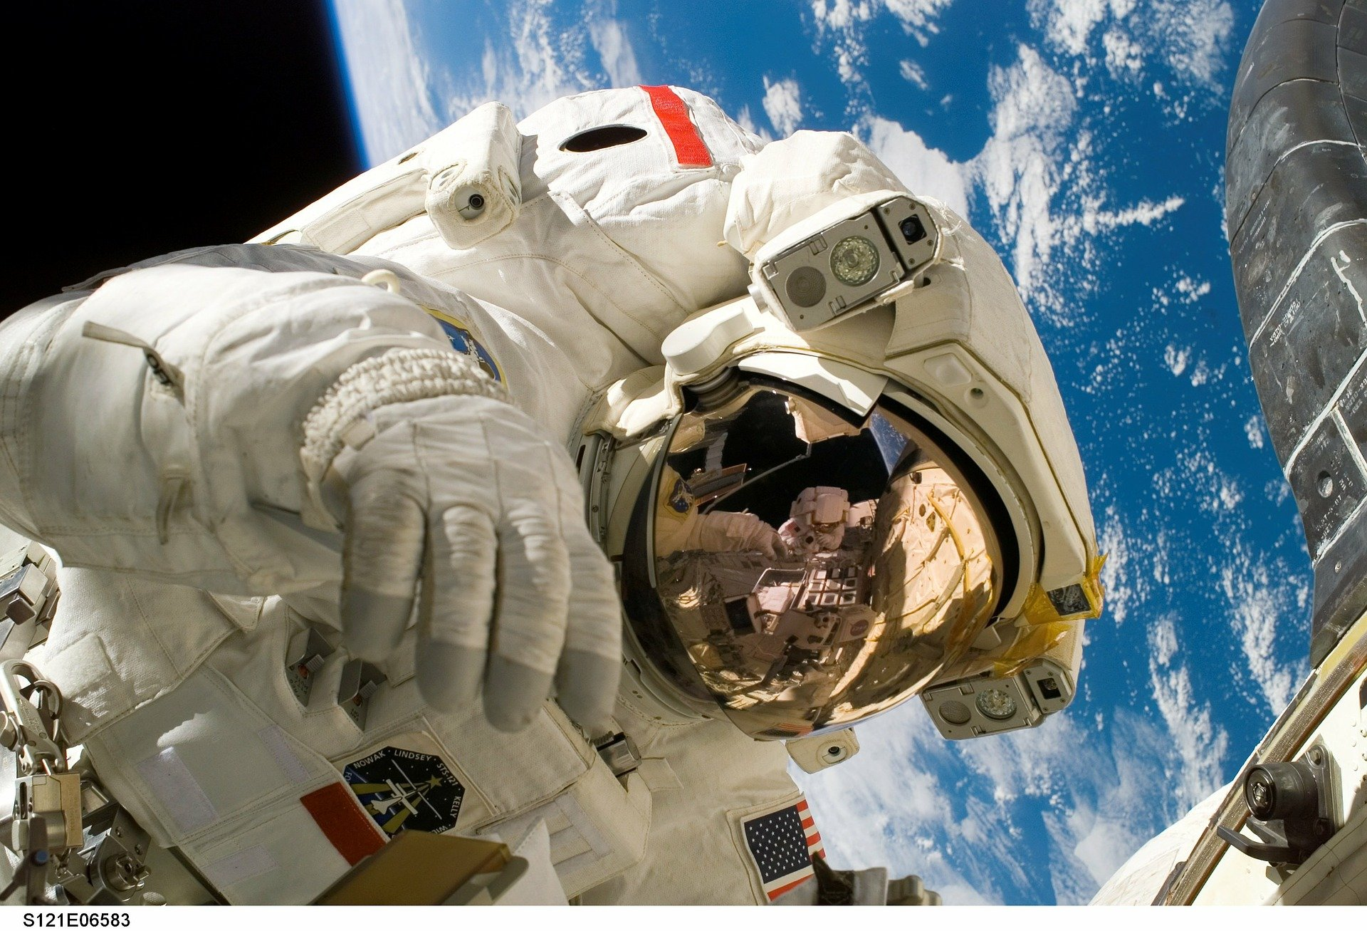
Let’s get started… better get your spacesuits on…

Slide 6

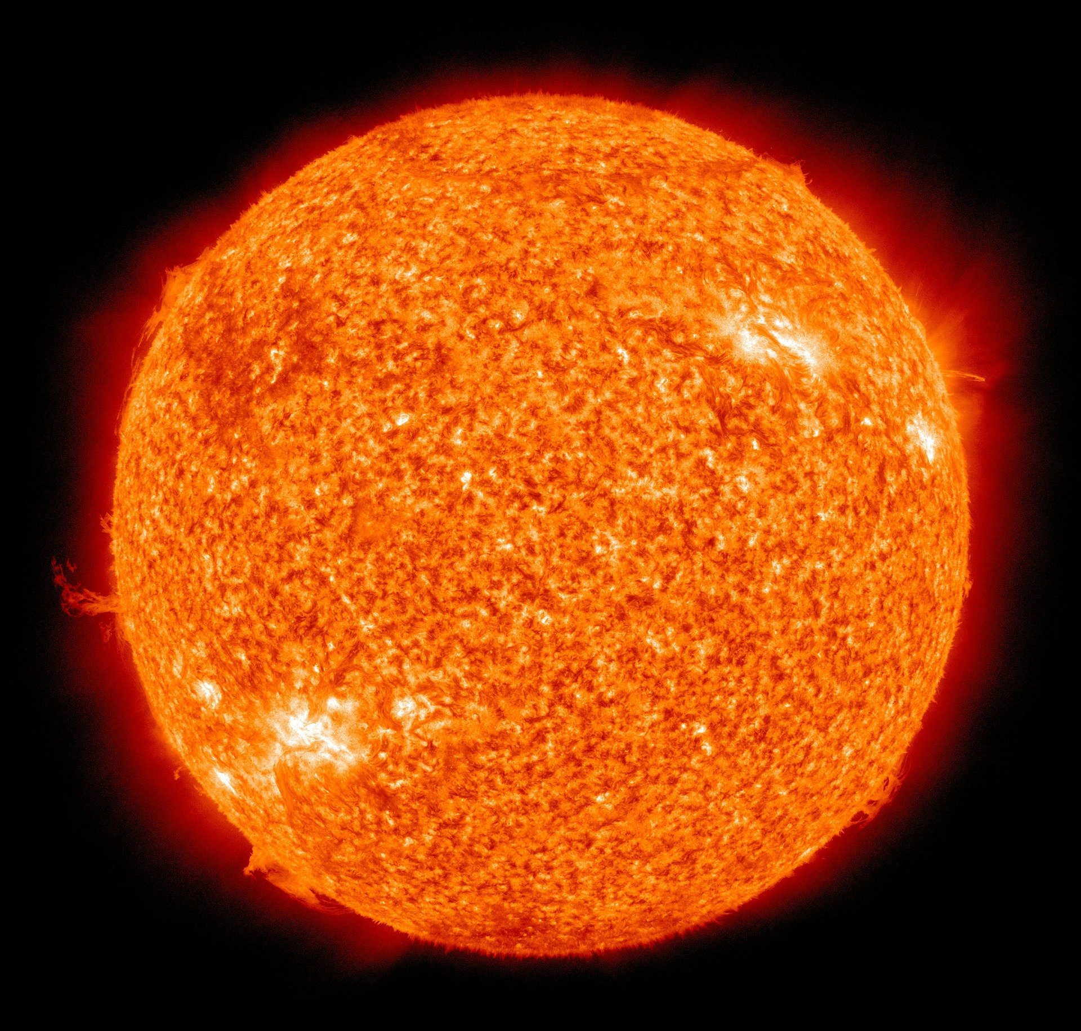
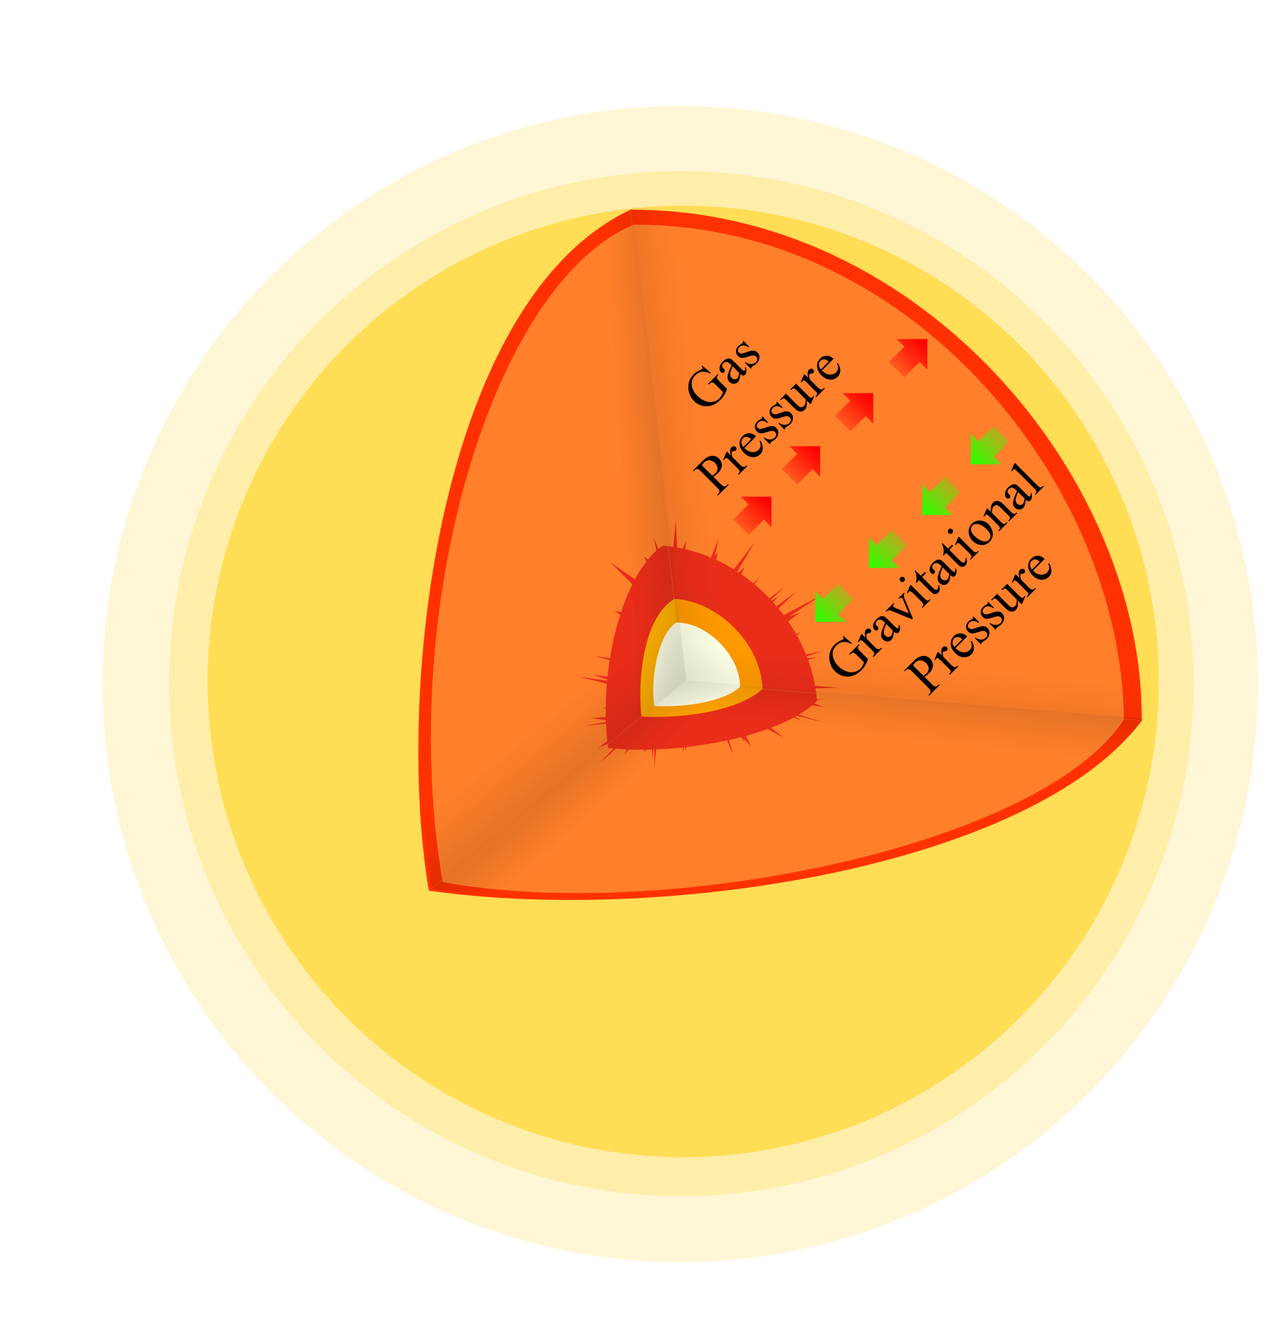
Stellar life cycle…
Stars have a fixed lifetime determined by how much fuel they contain.
When then run out of fuel, they expand, then violently contract (boom!).
He -> c
H -> He
C -> O
O -> Si
Si -> Fe
Fe
Elements with the Sun.
Our Sun.
Notes:
The Crab pulsar has a 33ms period (i.e. rotates 30 times a second).

Slide 7
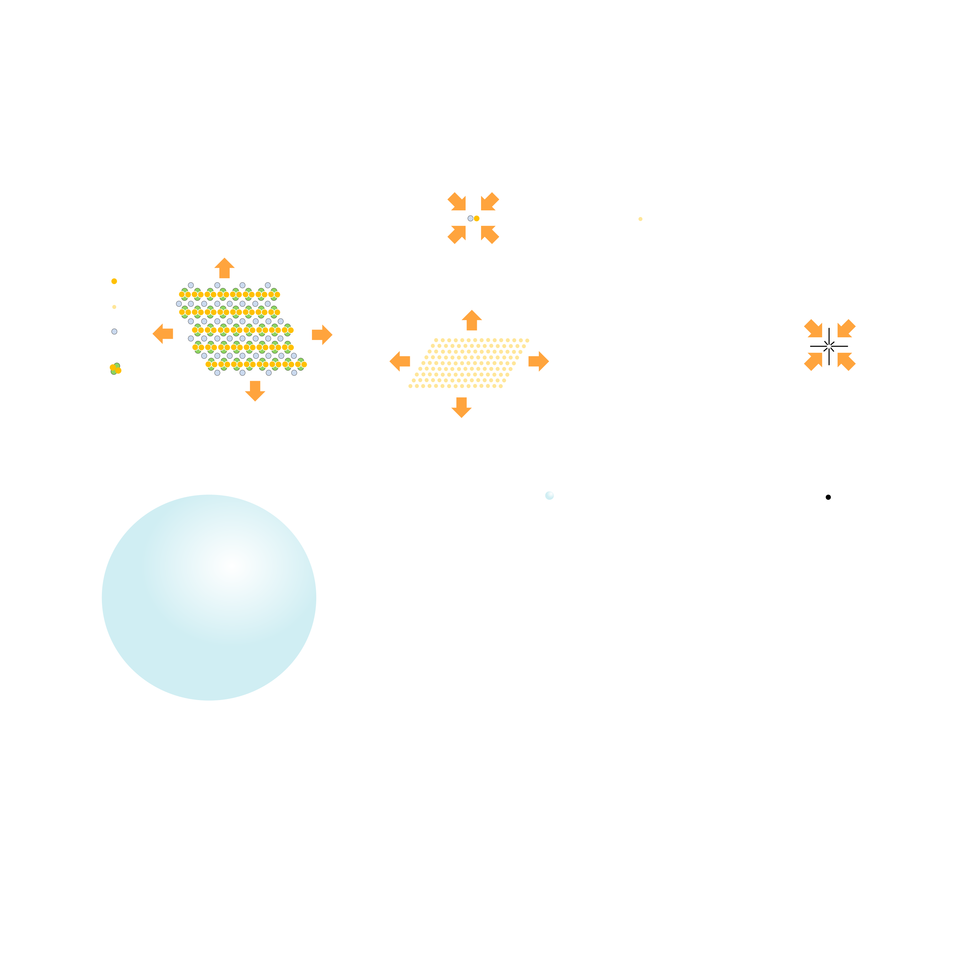
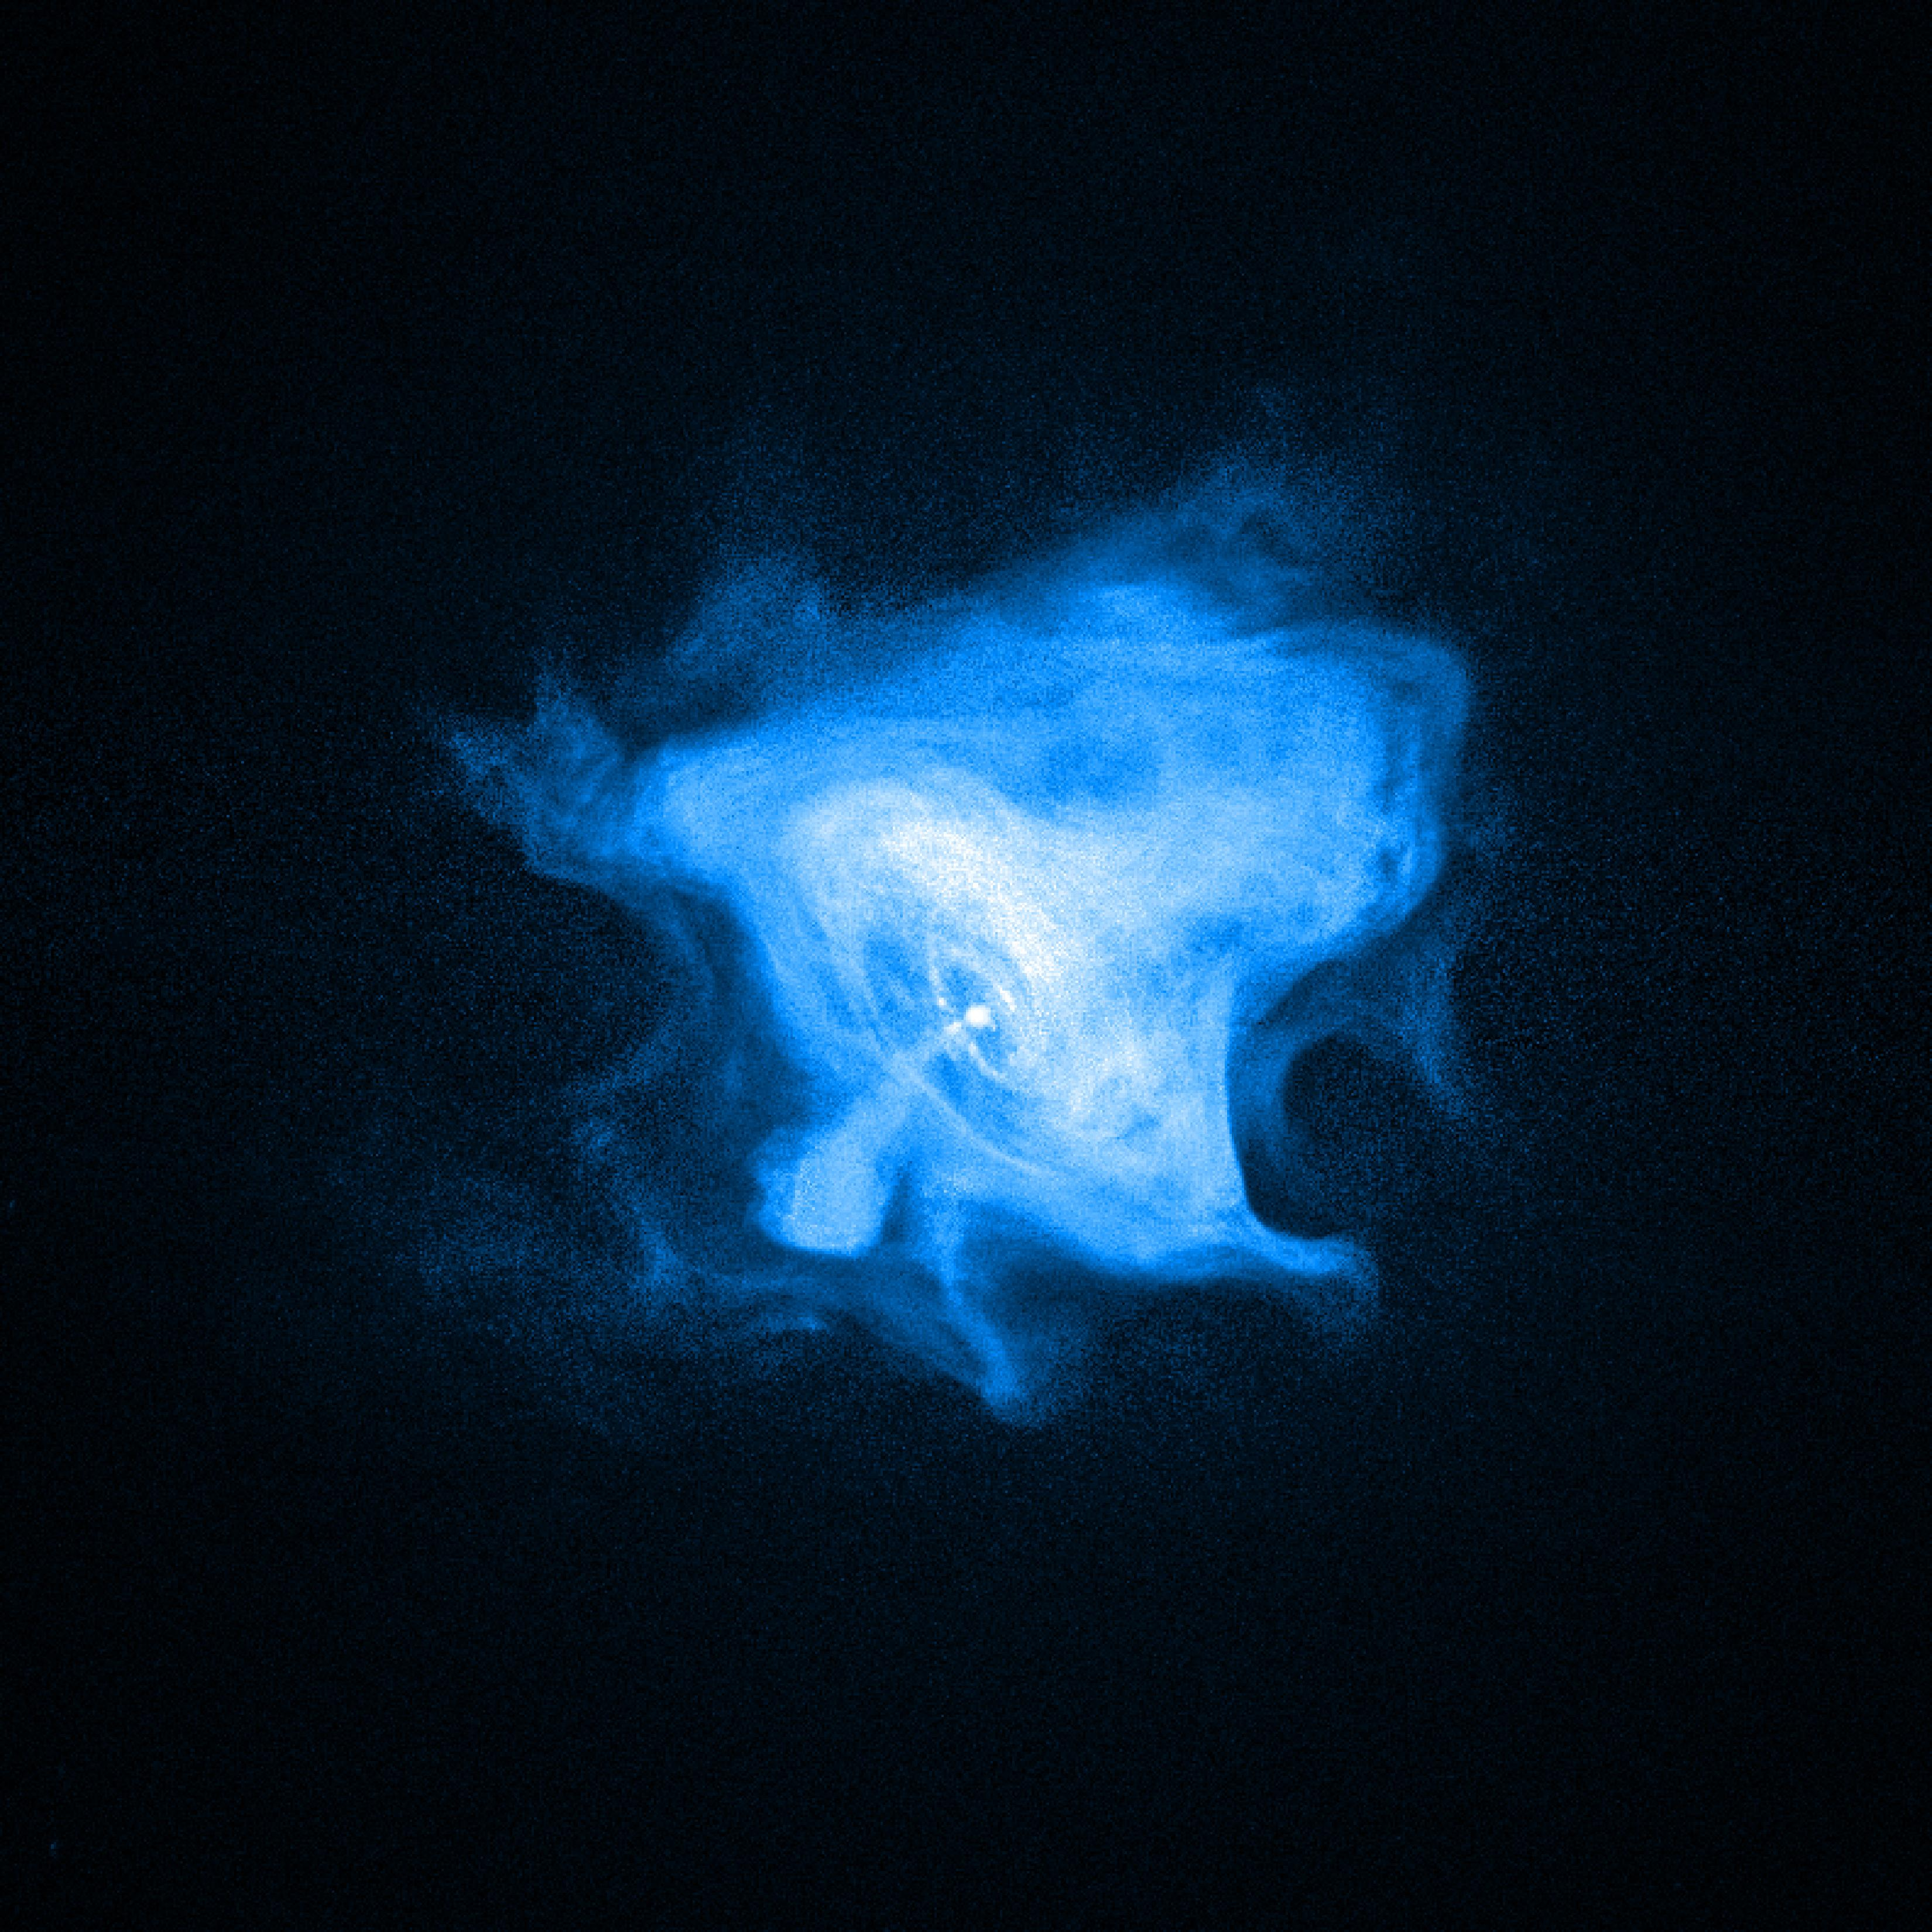
What happens next?
When a star goes supernova, a few things can happen:
It may form a White Dwarf star.
It may form a Neutron star.
It may form a Black Hole.
It all depends on the Star’s mass.
Some Neutron stars are special – they produce radio emission making them very useful… these are called Pulsars.
Notes:
The Crab pulsar has a 33ms period (i.e. rotates 30 times a second).

Slide 8
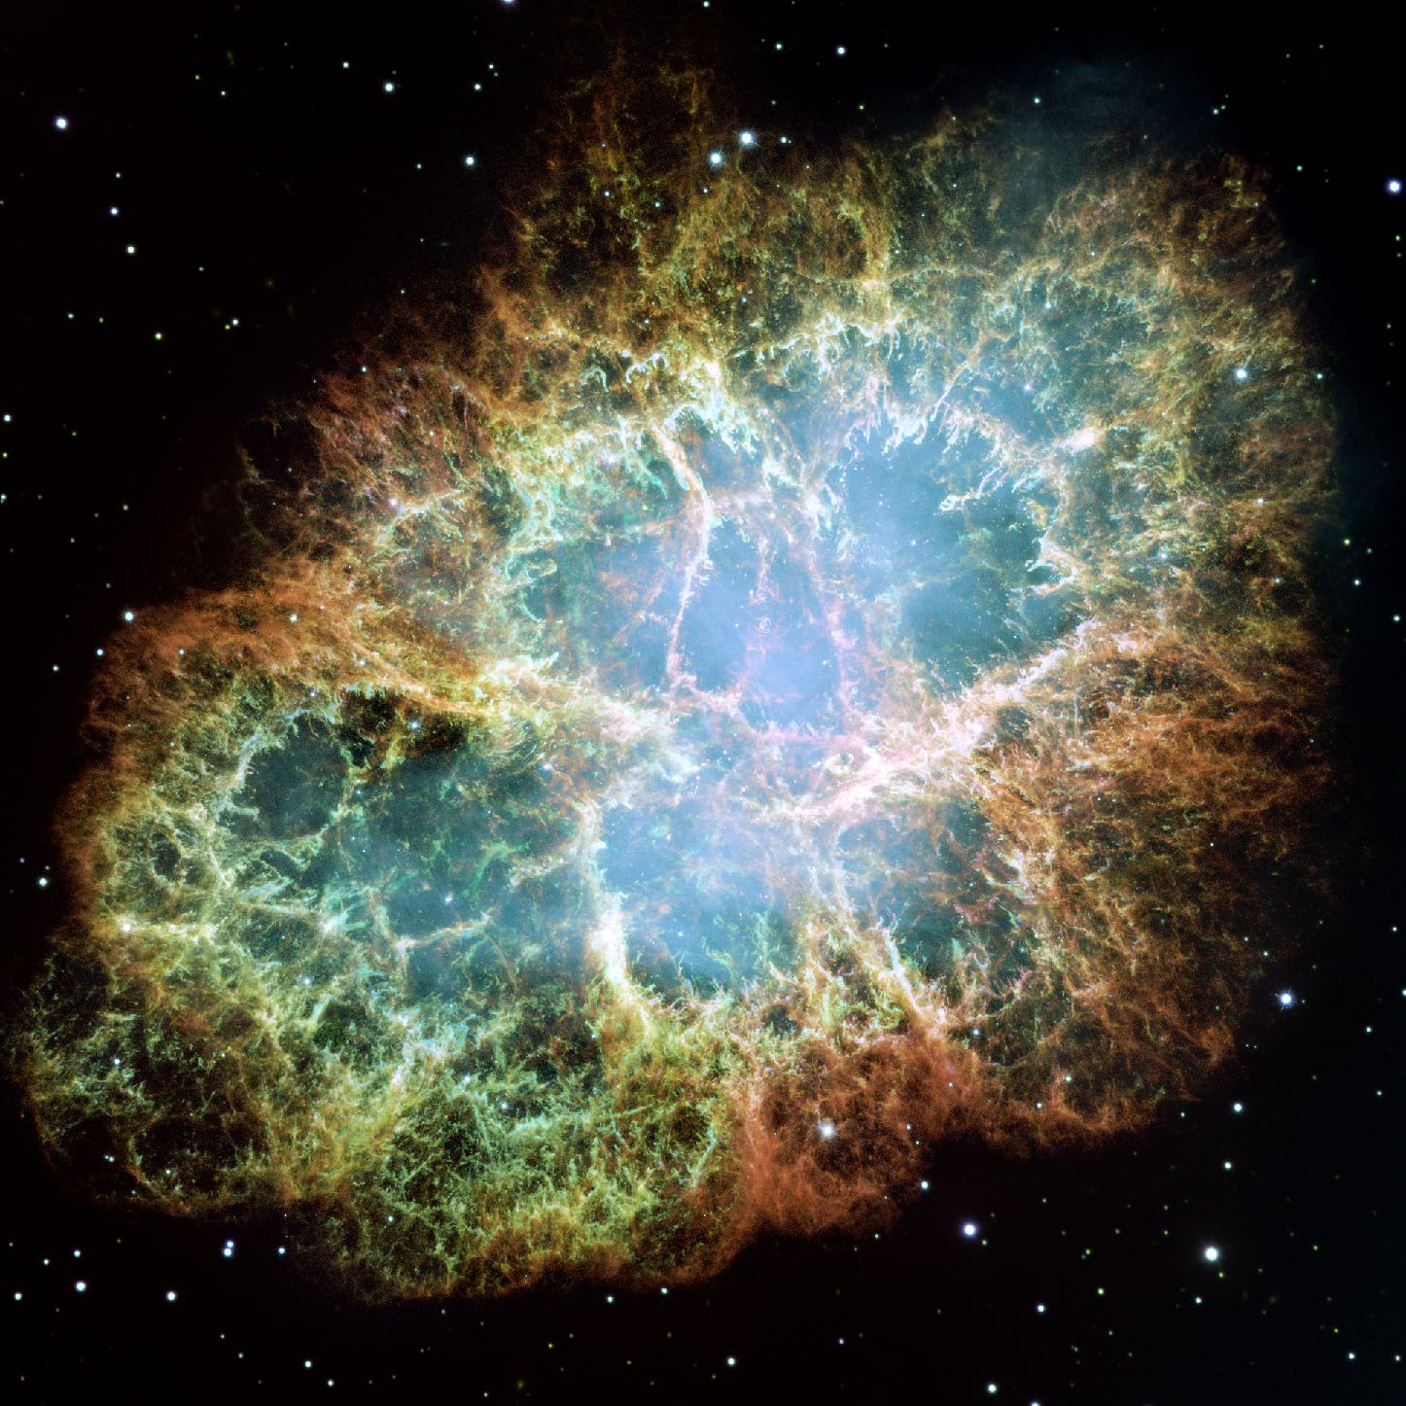
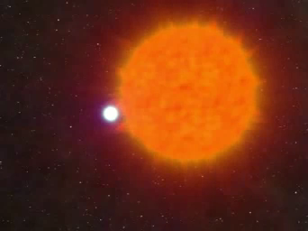
Pulsar Birth
Born during the collapse of especially massive stars (> 3.4 solar masses).
Credit: The Crab Pulsar Nebula NASA
Credit: John Rowe Animations
Notes:
The Crab pulsar has a 33ms period (i.e. rotates 30 times a second).

Slide 9
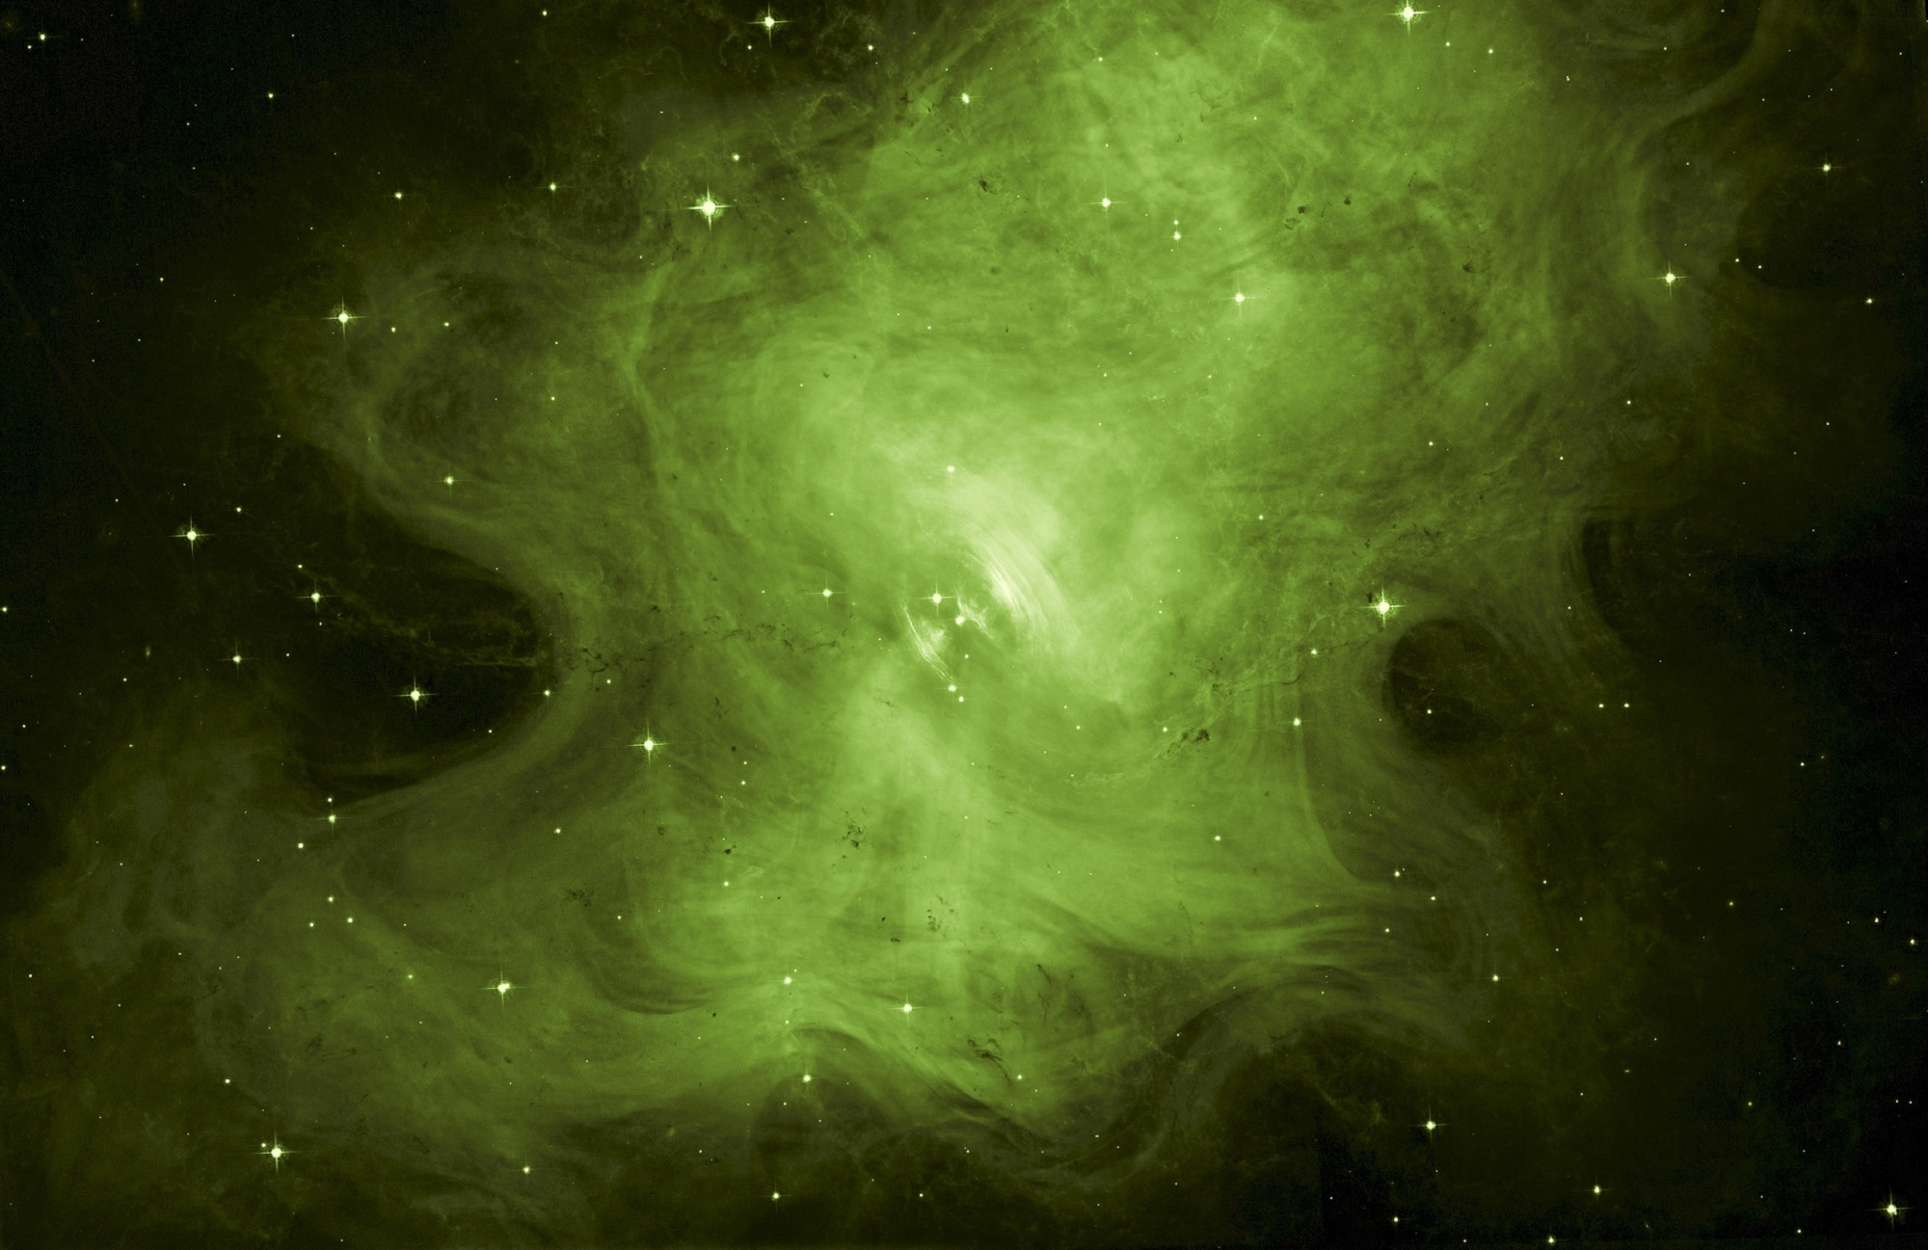
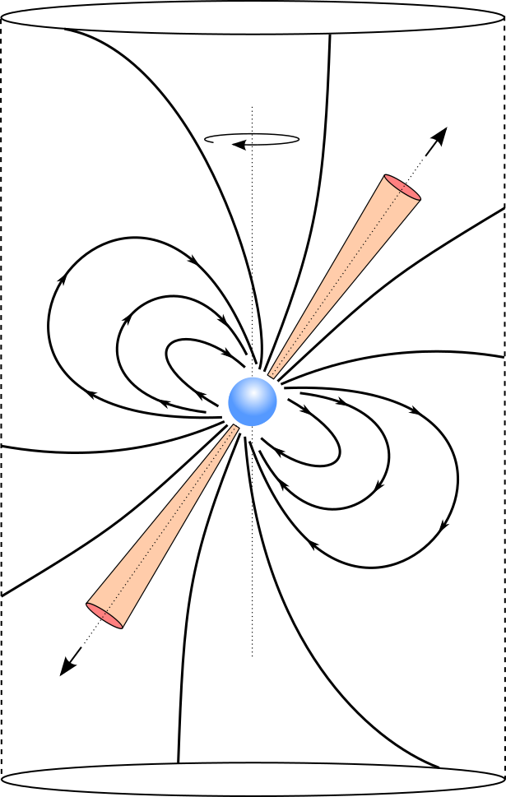
Radio Pulsars
Rotation
Axis
Magnetic Axis
Closed
field lines
Stellar remnant formed after a giant star collapses.
A type of Neutron Star, made entirely of neutrons.
Rapidly spinning star.
~20 km diameter.
Very dense objects – a teaspoon of pulsar material weighs as much as mount Everest!
Produce radio emission we can detect.
Very useful for science…. Hence we want to find as many as we can.
Light
Cylinder
Open field line
Radiation
Beam
Credit: NASA (Hubble)
Notes:
60 seconds - 1 minute 30 seconds

Slide 10
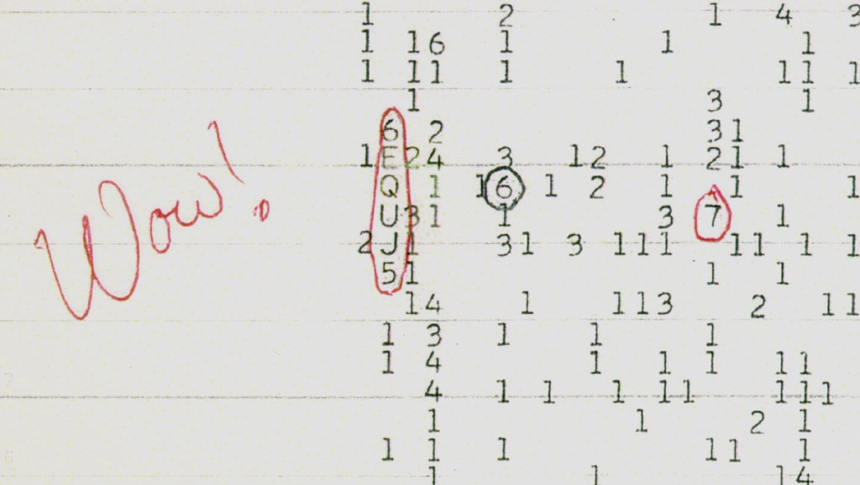
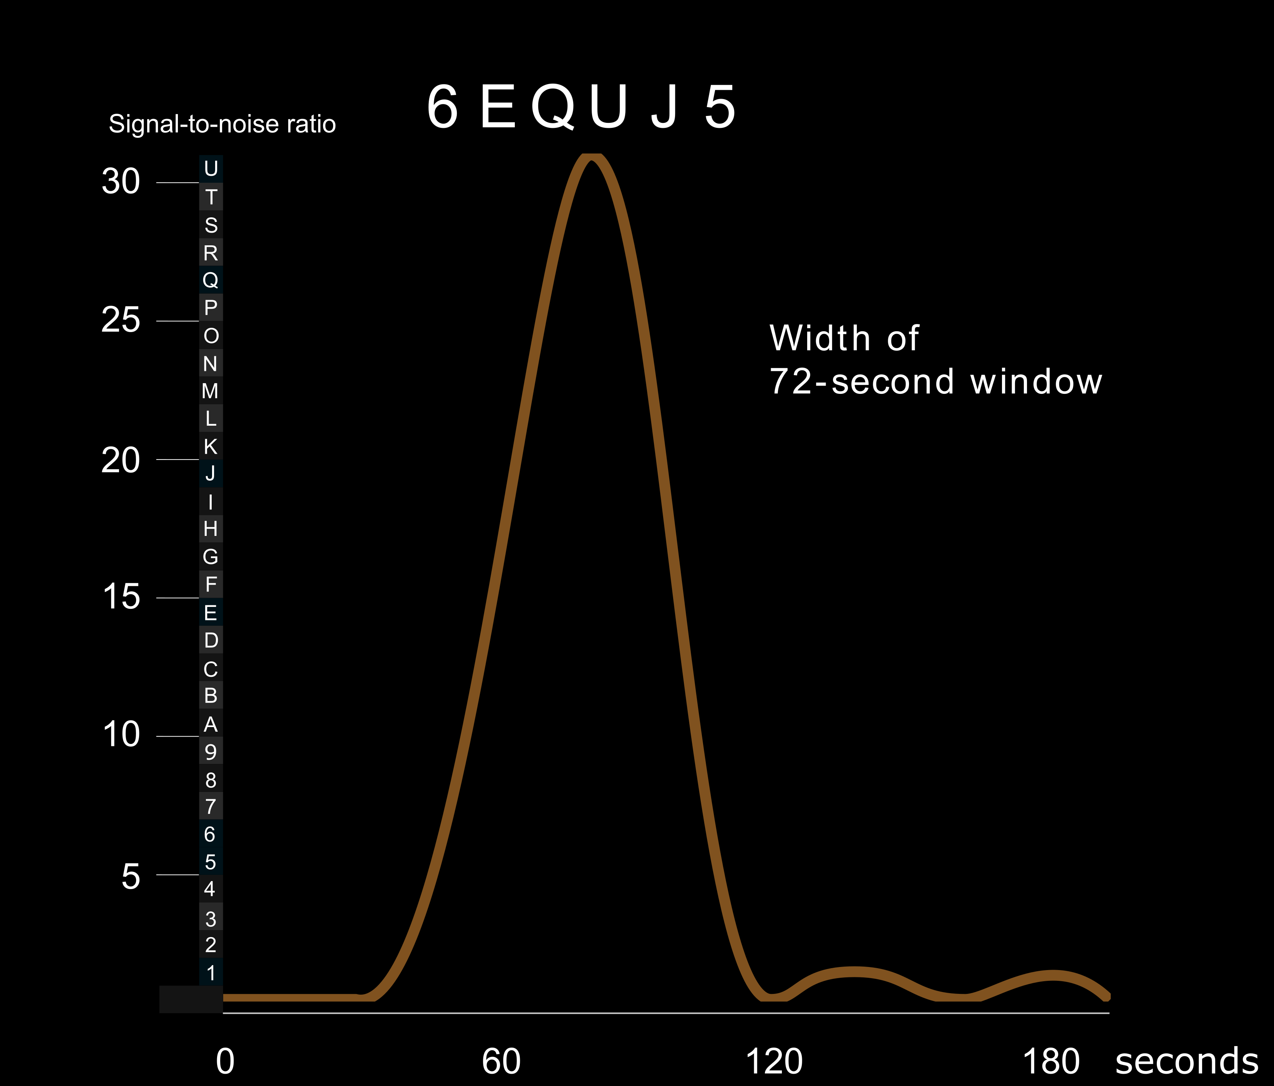
Why are they useful?
We can study how their signals are impacted via travel through space – allowing us to learn about the space between stars.
They allow us to understand how stars and the Galaxy evolves.
They helps us study Cosmic Magnetism.
They allow us to study extreme gravity.
Then while looking for them we also can also,
Conduct SETI Searches.
Discover new phenomena like fast radio bursts.
Search for gravitational waves…
Credit: North American AstroPhysical Observatory (NAAPO).
Notes:
Credit: Big Ear Radio Observatory and North American AstroPhysical Observatory (NAAPO).
Wow signal recorded in 1977, lasted 72 seconds, see at 1420.41 MHz (~hydrogen line), narrowband 10 kHz emission.

Slide 11
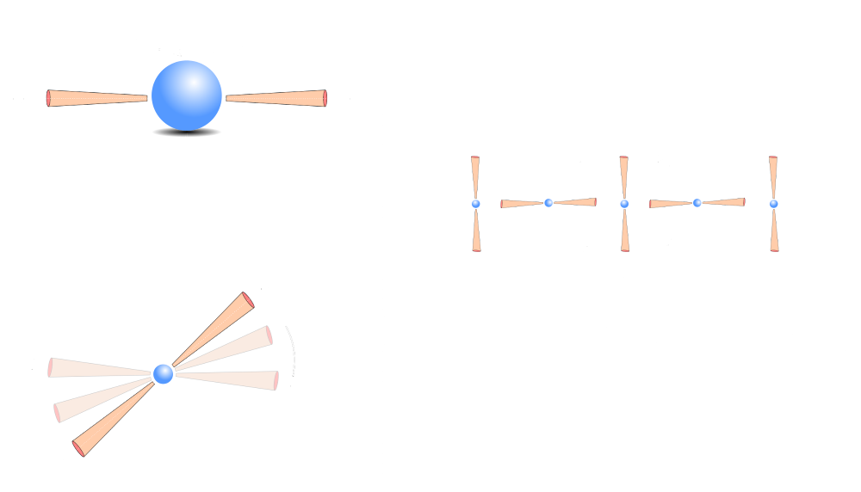
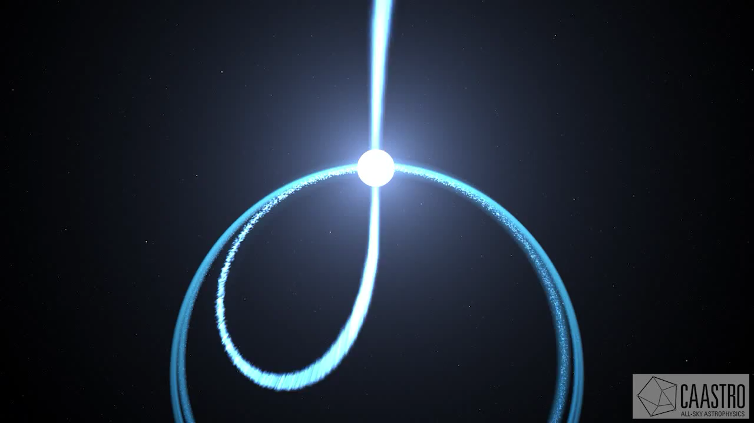
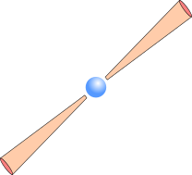
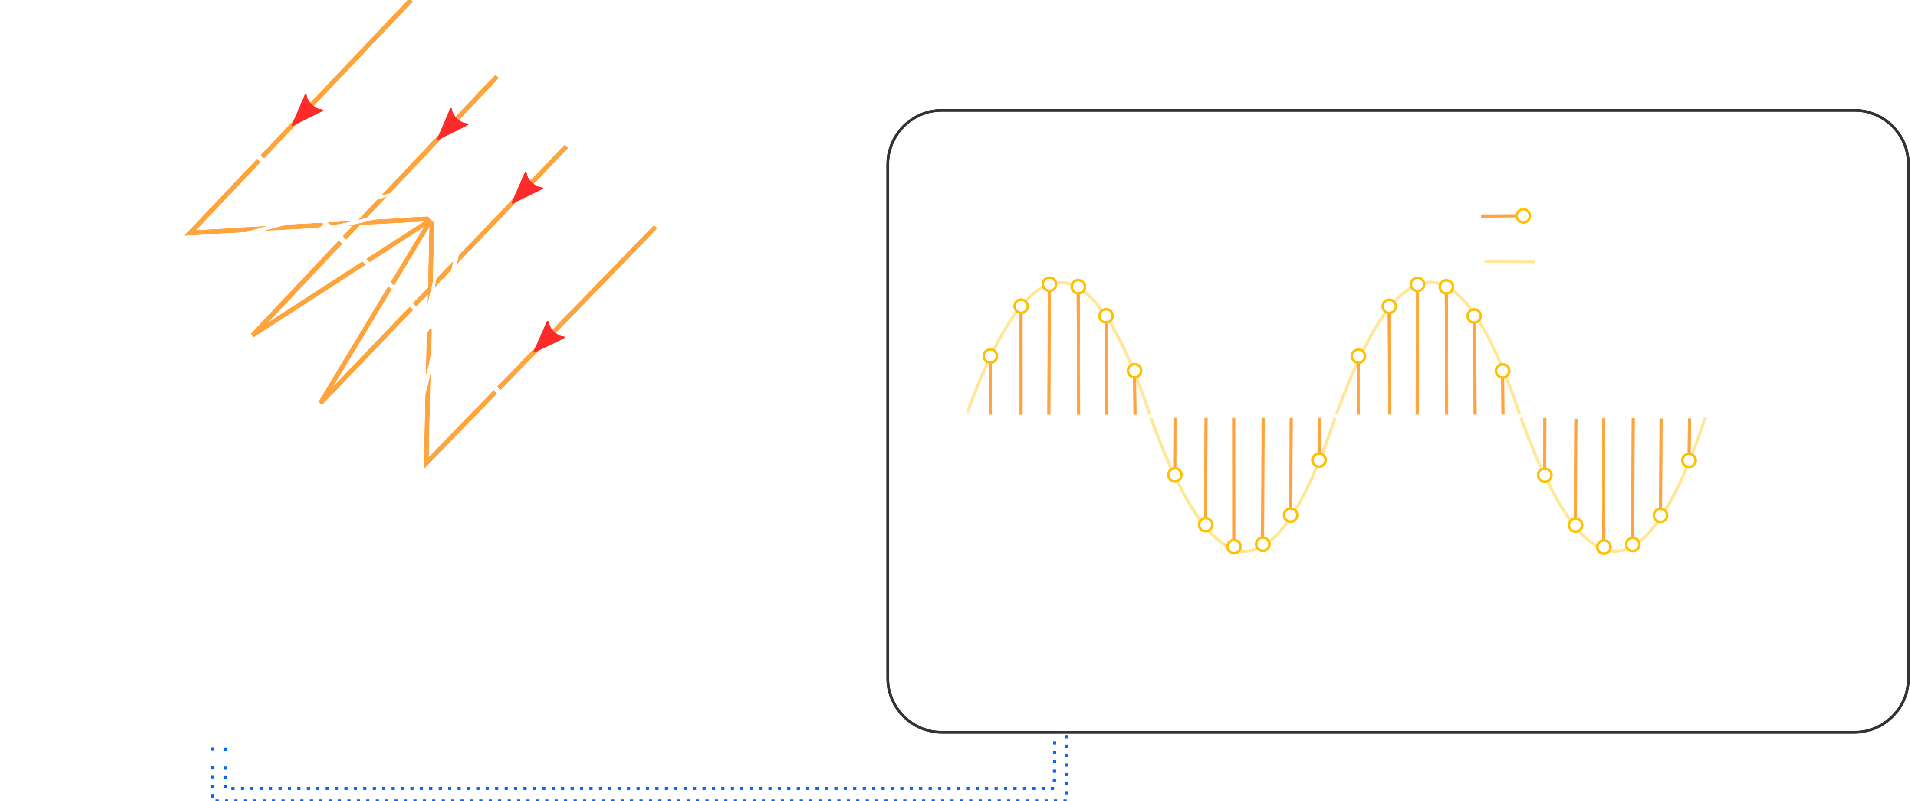

Pulsar Signals (radio waves)
Sweep of
Radiation
beam
Periodic signal
detected on Earth
Pulsars are unusual, because they produce radio emission.
As the pulsar rotates, these radio “beams” hit the Earth – if the beam crosses our line of sight.
These beams of emission can be detected on Earth using large radio telescopes.
The shape of the signal varies according to many factors – distance, rotation speed, objects in the way!
Notes:
The Crab pulsar has a 33ms period (i.e. rotates 30 times a second).

Slide 12

Pulse Profiles
To study such signals, we observe pulsars over many thousands of rotations.
We average the pulses over those rotations forming a pulse profile – think of it like the finger print of the pulsar.
All pulsar signals are different, making them hard to search for – because we don’t know exactly what to look for.
Complex Pulse Profiles
Notes:
The Crab pulsar has a 33ms period (i.e. rotates 30 times a second).

Slide 13
Capturing data for study
Pulsar signals are weak, thus to find them, we must use large radio telescopes.
We use complex software pipelines to ingest and process data collected.
The processing creates pulsar candidates – files describing detected signals.
Incoming
radiation
Digital Sample
Analog Signal
Data sampling / Search

Slide 14

Candidates - What are we looking for then?
Clear pulse with a defined peak in a).
Evidence that the signal persists in time, i.e. an indication of a periodic source. Shown in d).
Evidence that the signal persists in frequency - pulsars are broadband emitters shown in c).
A DM value greater than zero shown in b).
Evidence of other effects, such as scintillation?
Clear signal
with a peak
DM > 0, i.e. peak > 0
Present through freq.
Present through time
Notes:
The Crab pulsar has a 33ms period (i.e. rotates 30 times a second).

Slide 15
Candidates - What are we looking for then?
Just to be clear – here’s what the matrices represent…
They describe a birds eye view of multiple signals observed over time / freq.
Birds eye-view of multiple pulses over time / freq.
Notes:
The Crab pulsar has a 33ms period (i.e. rotates 30 times a second).

Slide 16
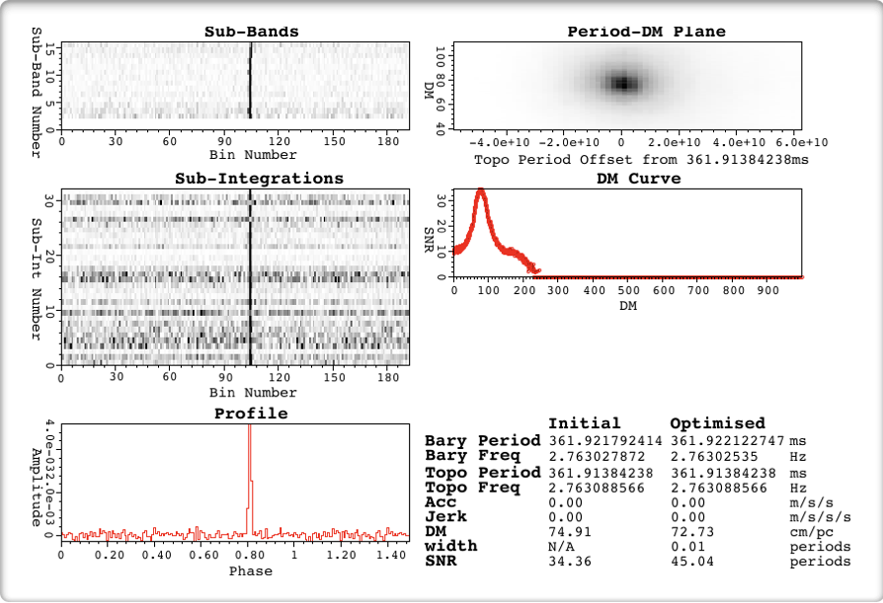
Candidate Example (1)
Defined peak.
Clear DM peak > 0.
Consistent in time.
Persistent in frequency.
Obvious pulsar!
Frequency
Time
DM
Signal
Credit: HTRU Collaboration.
Notes:
The Crab pulsar has a 33ms period (i.e. rotates 30 times a second).

Slide 17

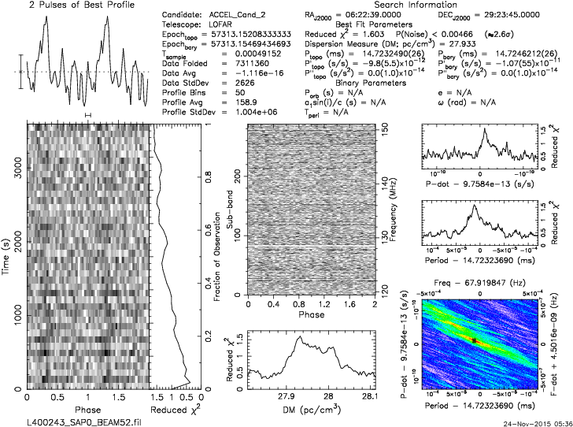
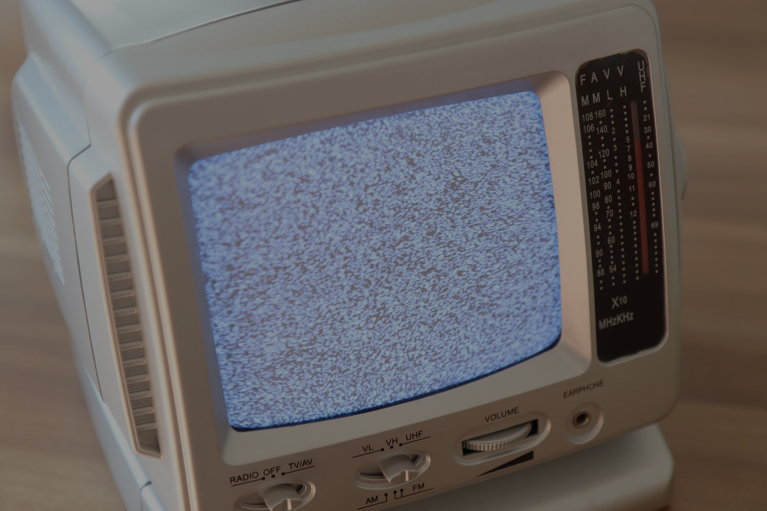
Candidate Example (2)
Clearly defined peak?
Some persistence in time?
A DM value > zero
This is just “noise”.
Freq.
Signal
Time
DM
Just like TV static.
Credit: LOTAAS Collaboration.
Notes:
The Crab pulsar has a 33ms period (i.e. rotates 30 times a second).

Slide 18

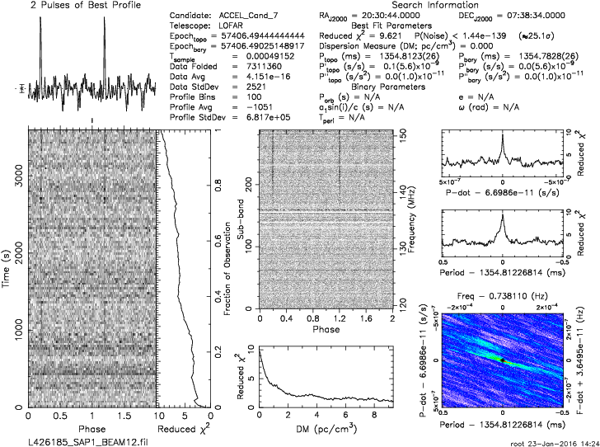

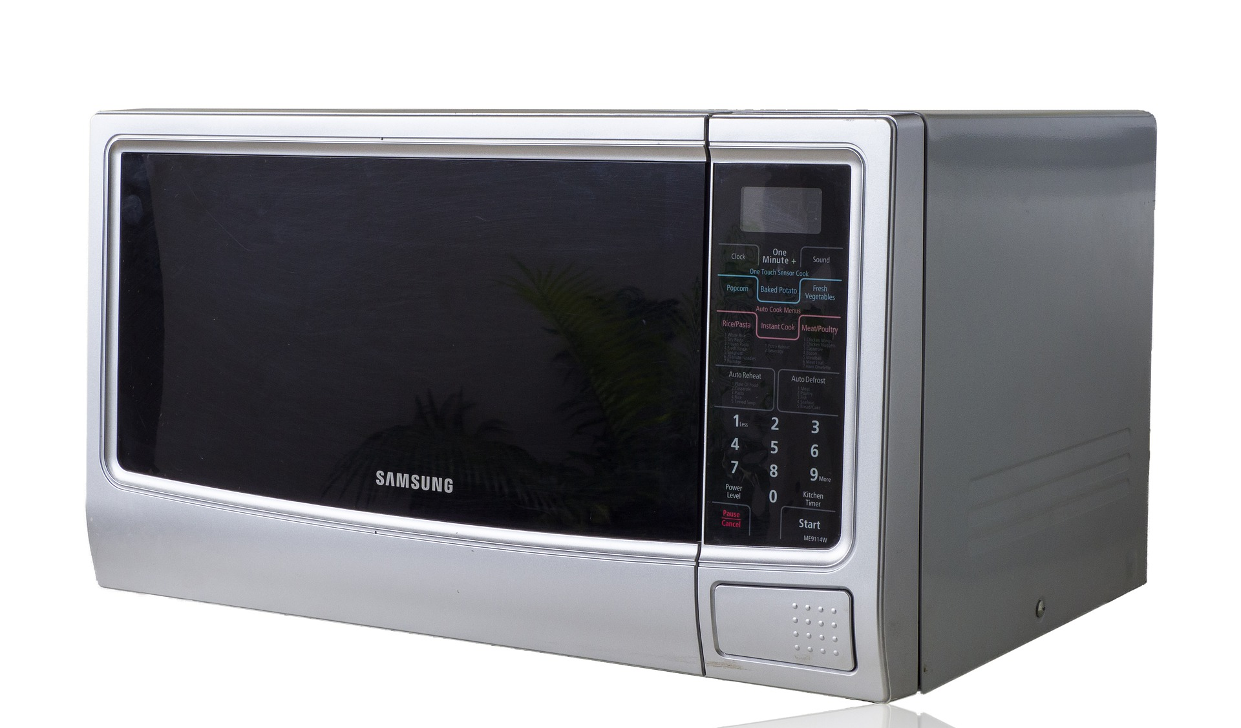
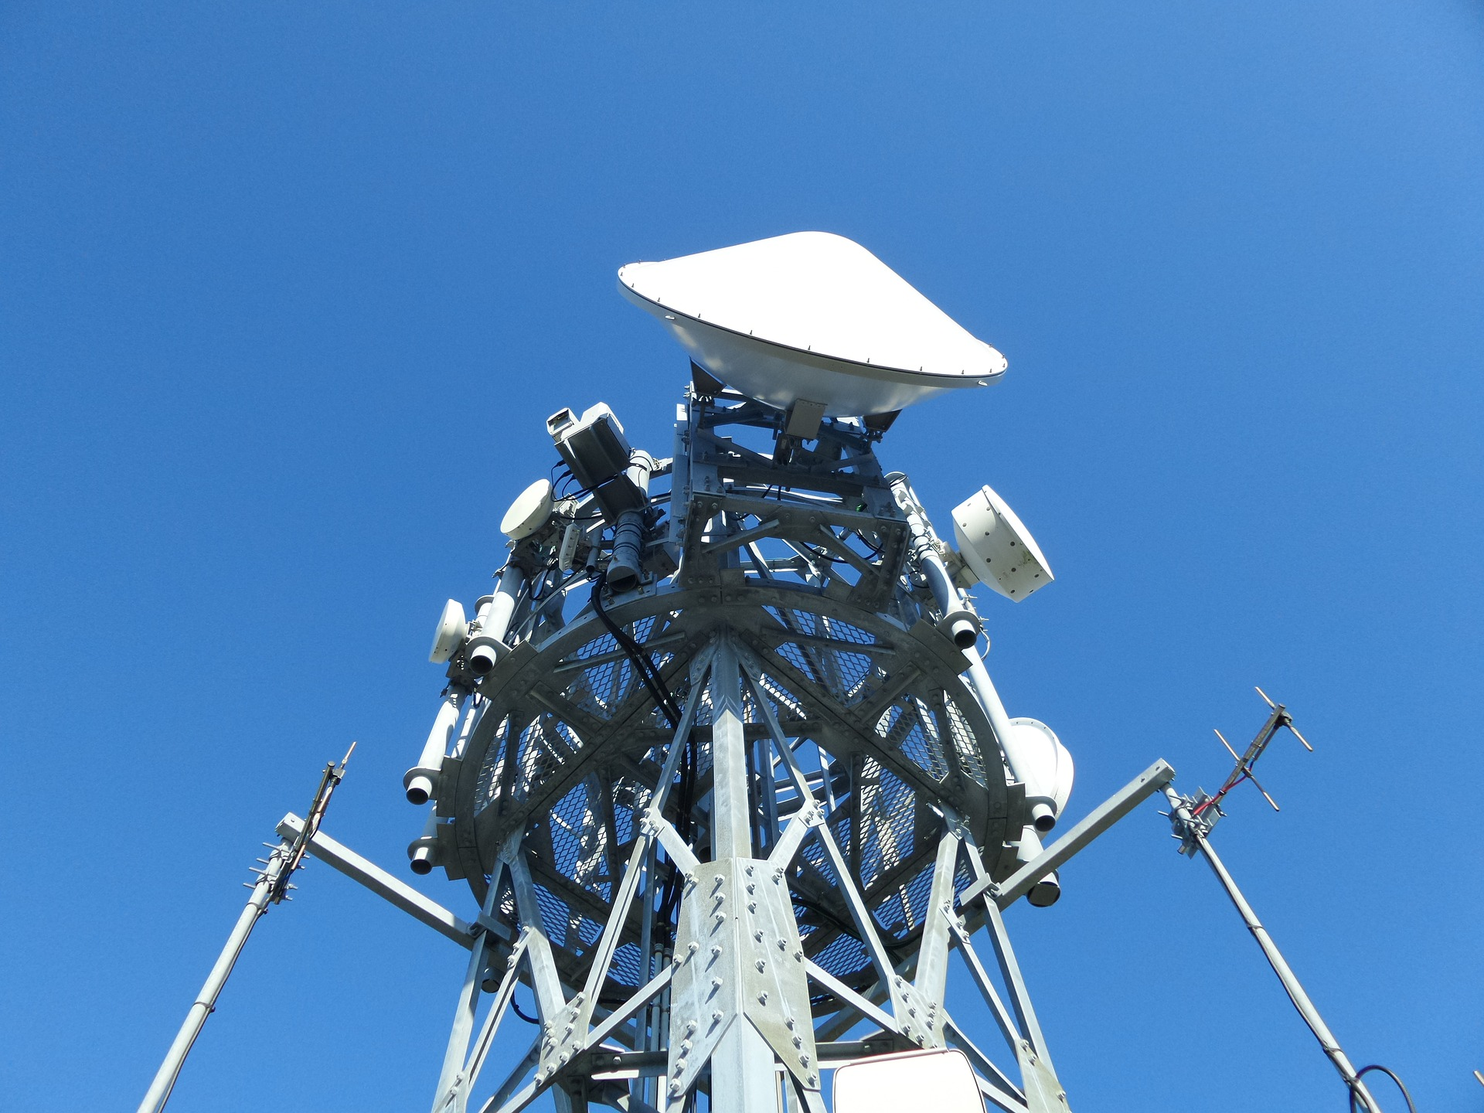
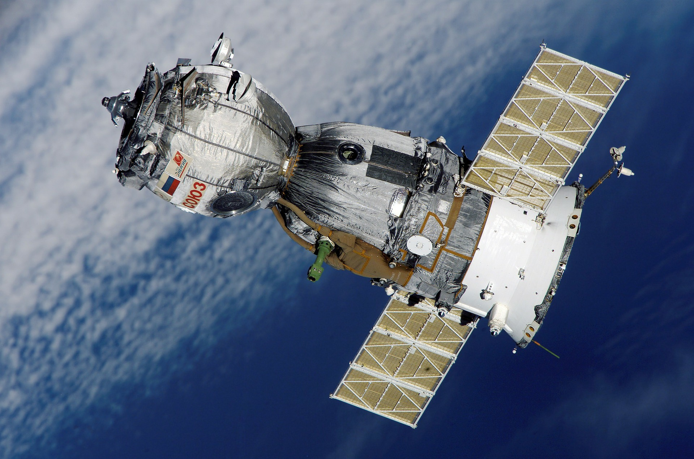
Candidate Example (3)
Clearly defined peak?
Some persistence in time?
Some persistence in frequency.
A DM value <= zero
This is “interference”.
Freq.
Signal
Time
DM
Credit: LOTAAS Collaboration.
Pick your culprit.
Notes:
The Crab pulsar has a 33ms period (i.e. rotates 30 times a second).

Slide 19
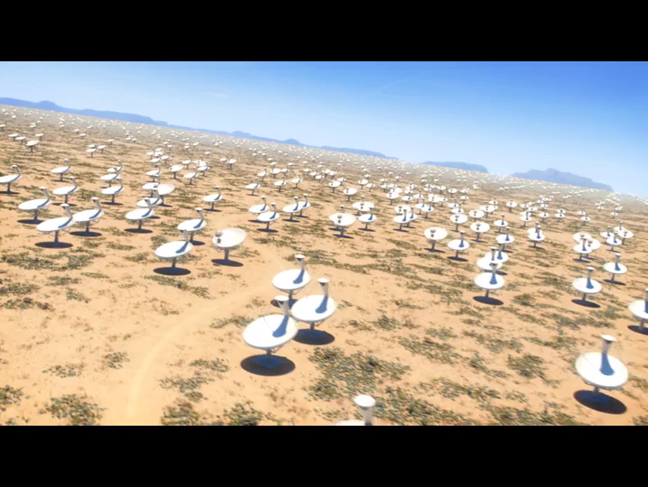
Classifying candidates
Deciding if a candidate is real or fake is not always easy.
To make matters worse, telescopes generate huge volumes of candidates.
This makes the problem particularly hard to solve.
For every real signal there are at least 10,000 caused by noise or RFI…
I’m part of the project to build the worlds largest radio telescope – it will generate millions of candidates per observation!!!
We need help to tackle this – computer science to the rescue?
Credit: SKAO
Notes:
The Crab pulsar has a 33ms period (i.e. rotates 30 times a second).

Slide 20
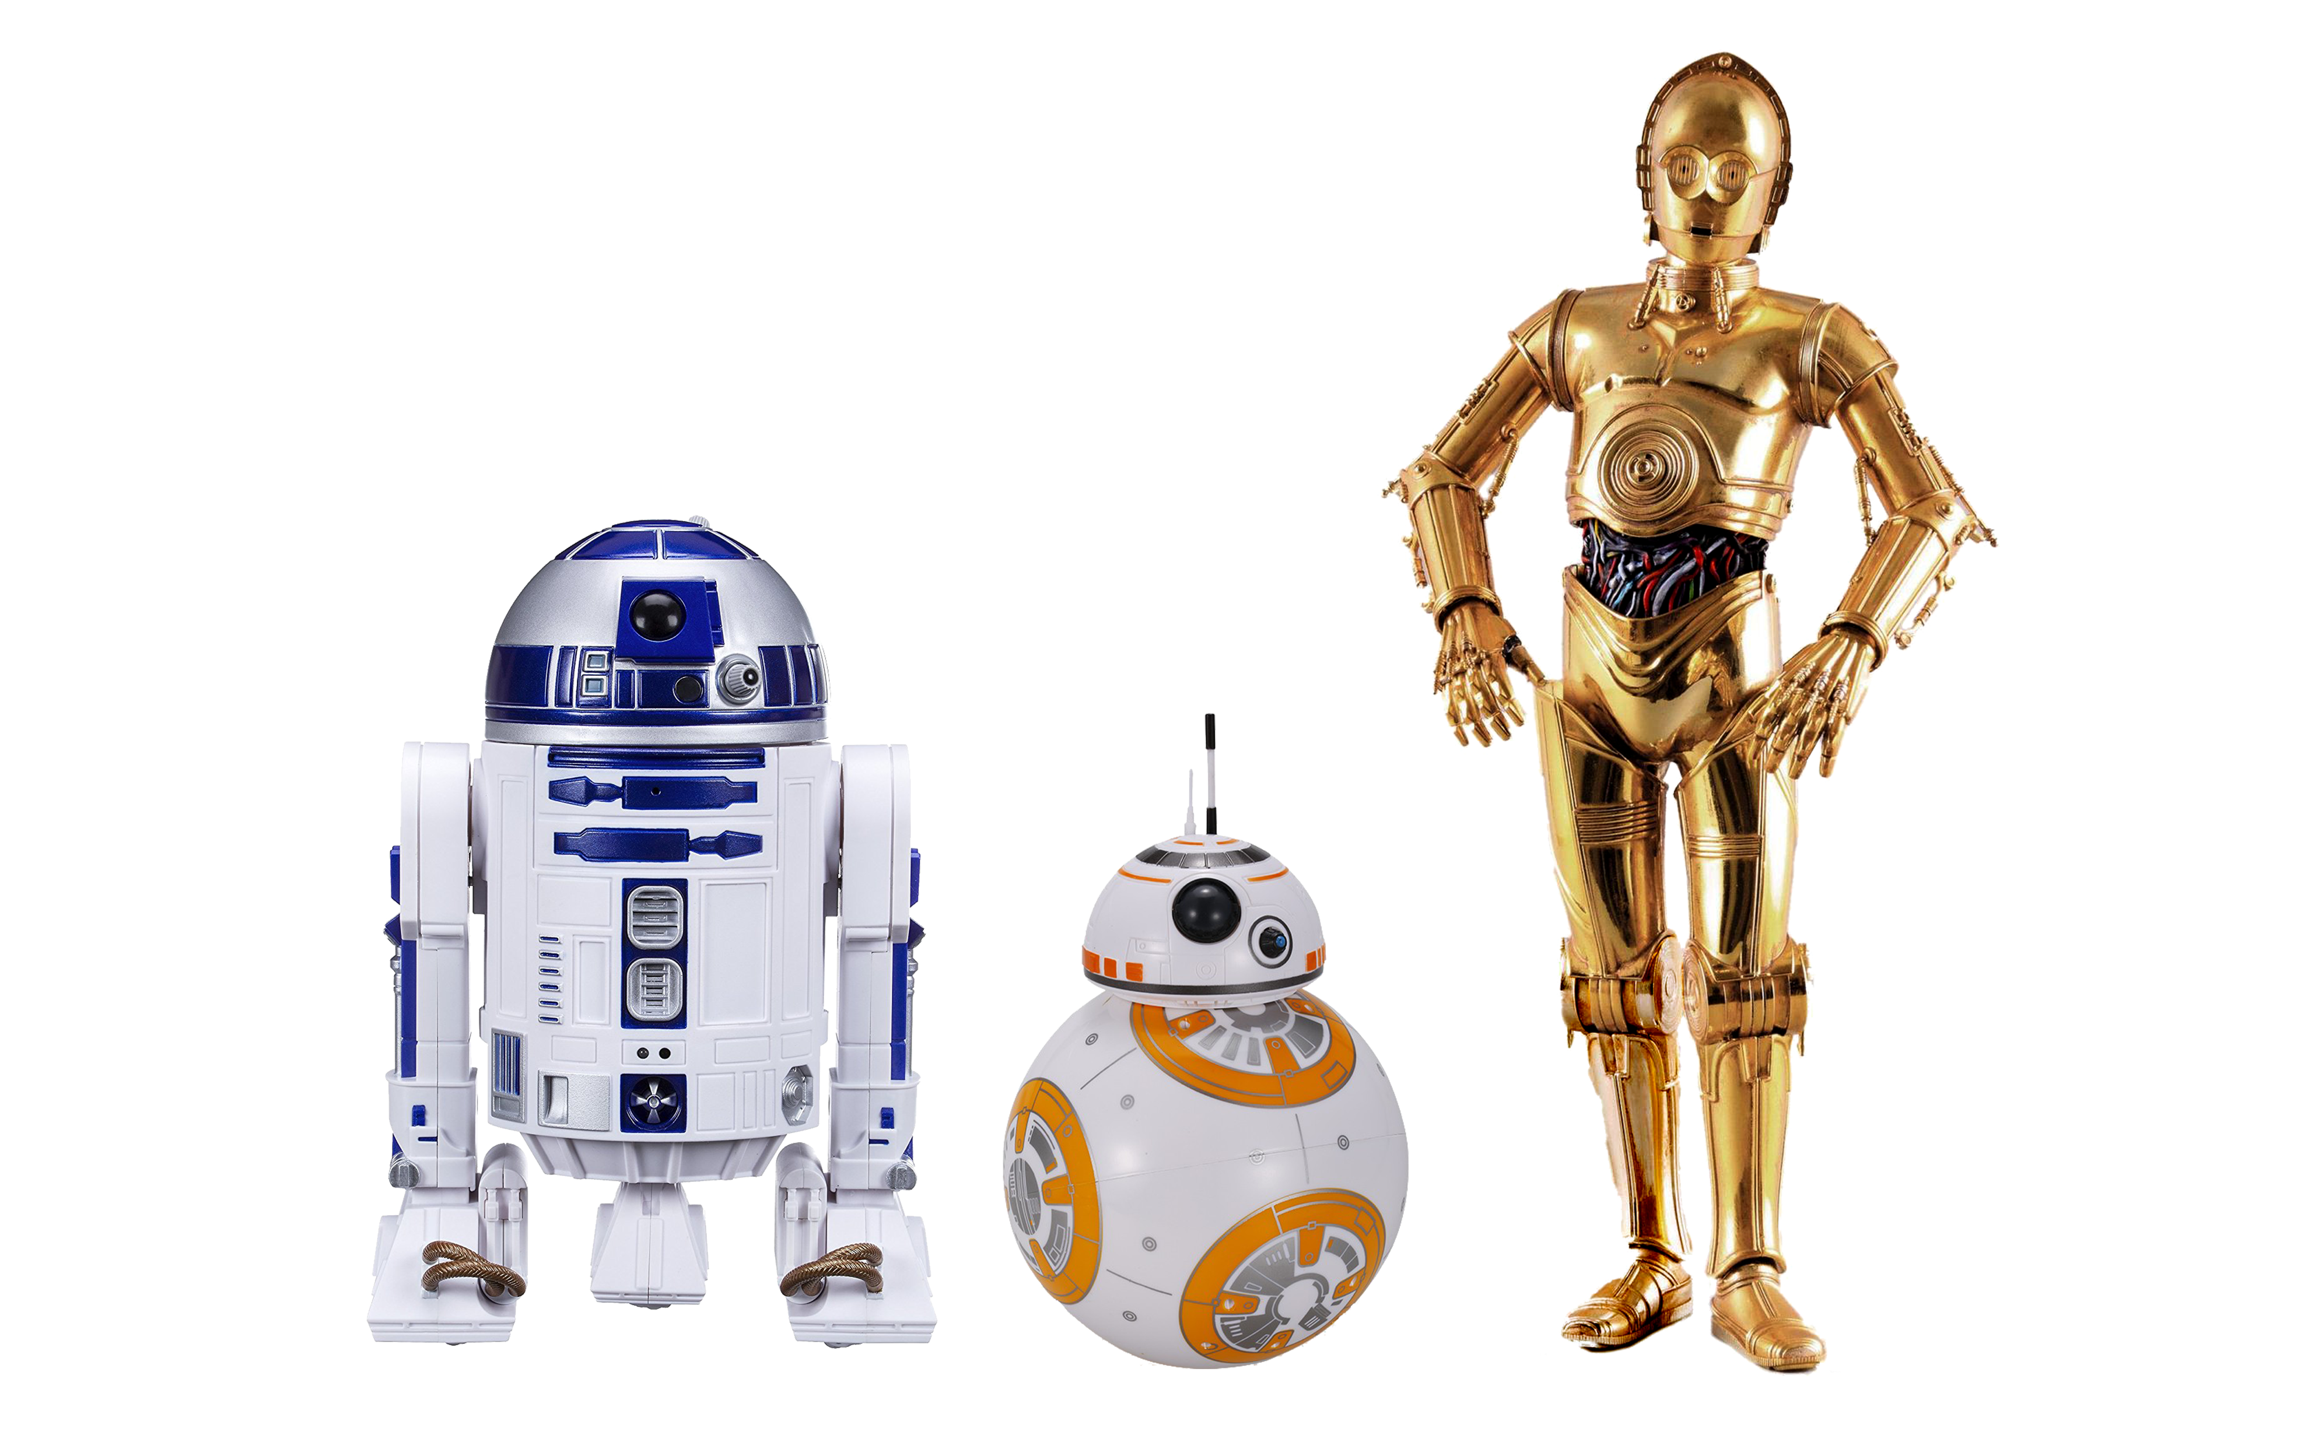
Computer scientists to the rescue (well, A.I. really)!

Slide 21
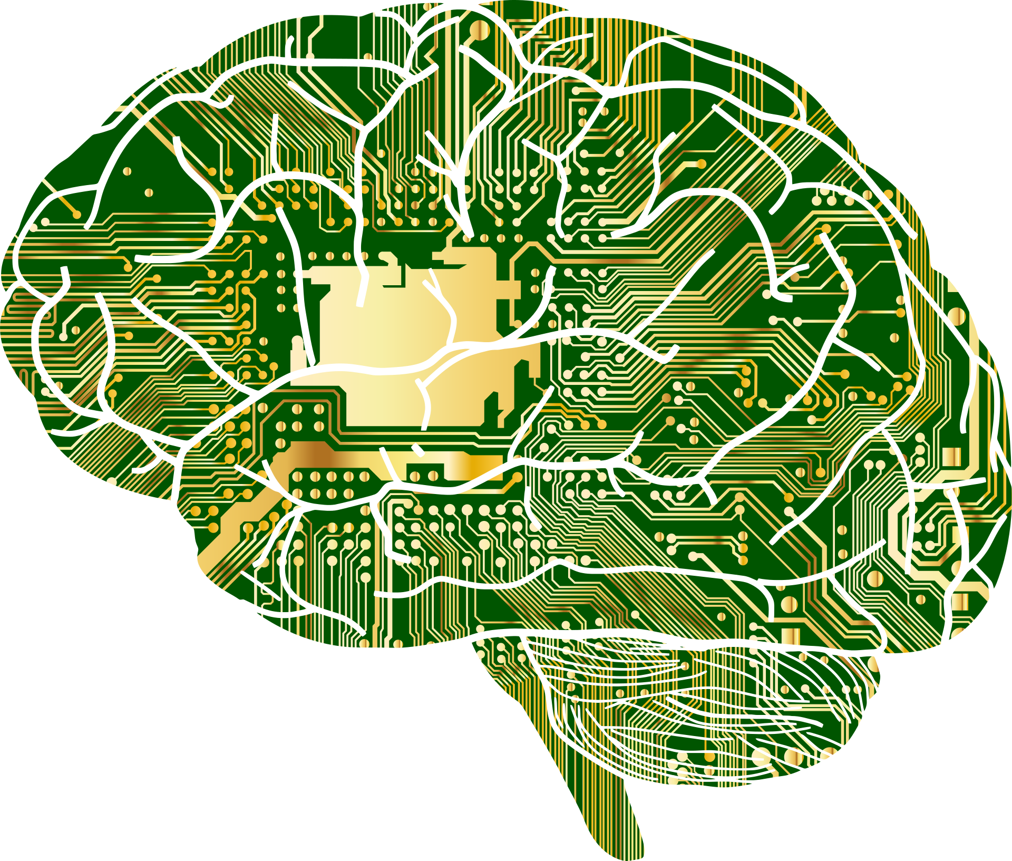
Artificial Intelligence
Artificial Intelligence (A.I.) is a field of study concerned with reproducing / replicating human intelligence.
A.I. is an umbrella term – it is comprised of many sub-fields of study.
Here we’ll talk about replicating the human capacity for learning – learning to recognise real from spurious candidates.
This field is known more generally as “Machine Learning”.
Talking
Consciousness
Seeing
Moving
Listening
Understanding
Language
Reasoning
Learning

Slide 22
Machine Learning
Machine learning (ML) is a fascinating field. It combines insights from statistics, logic, psychology and neuroscience to build automated systems capable of “learning” by themselves.
ML isn’t concerned with replicating exactly how humans learn, after all, we’re flawed!
Instead it focuses on developing ways to make optimal decisions/predictions using available information.
For this problem, we use candidate examples to “teach” an algorithm to recognise real and spurious.
Learning

Slide 23
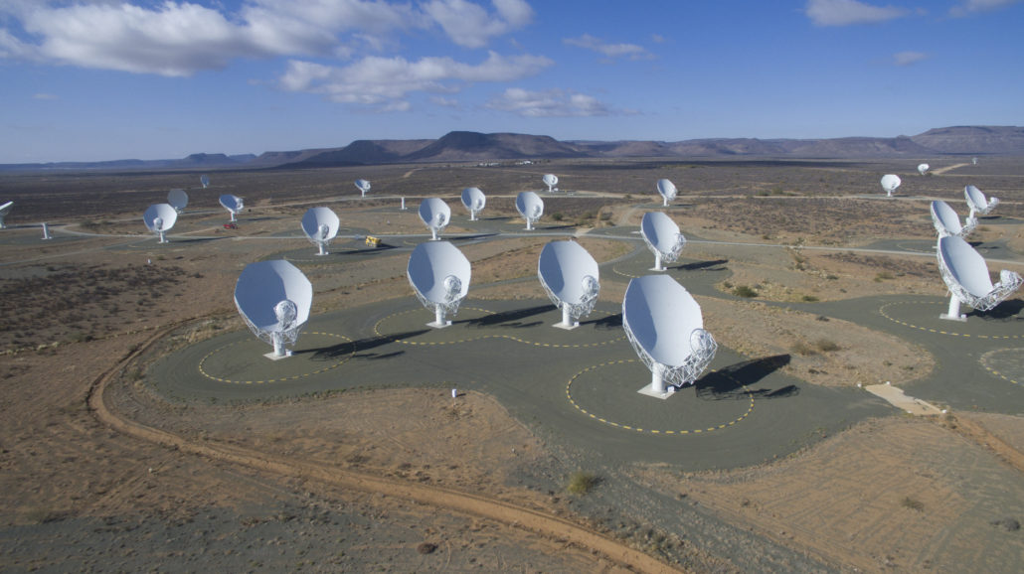
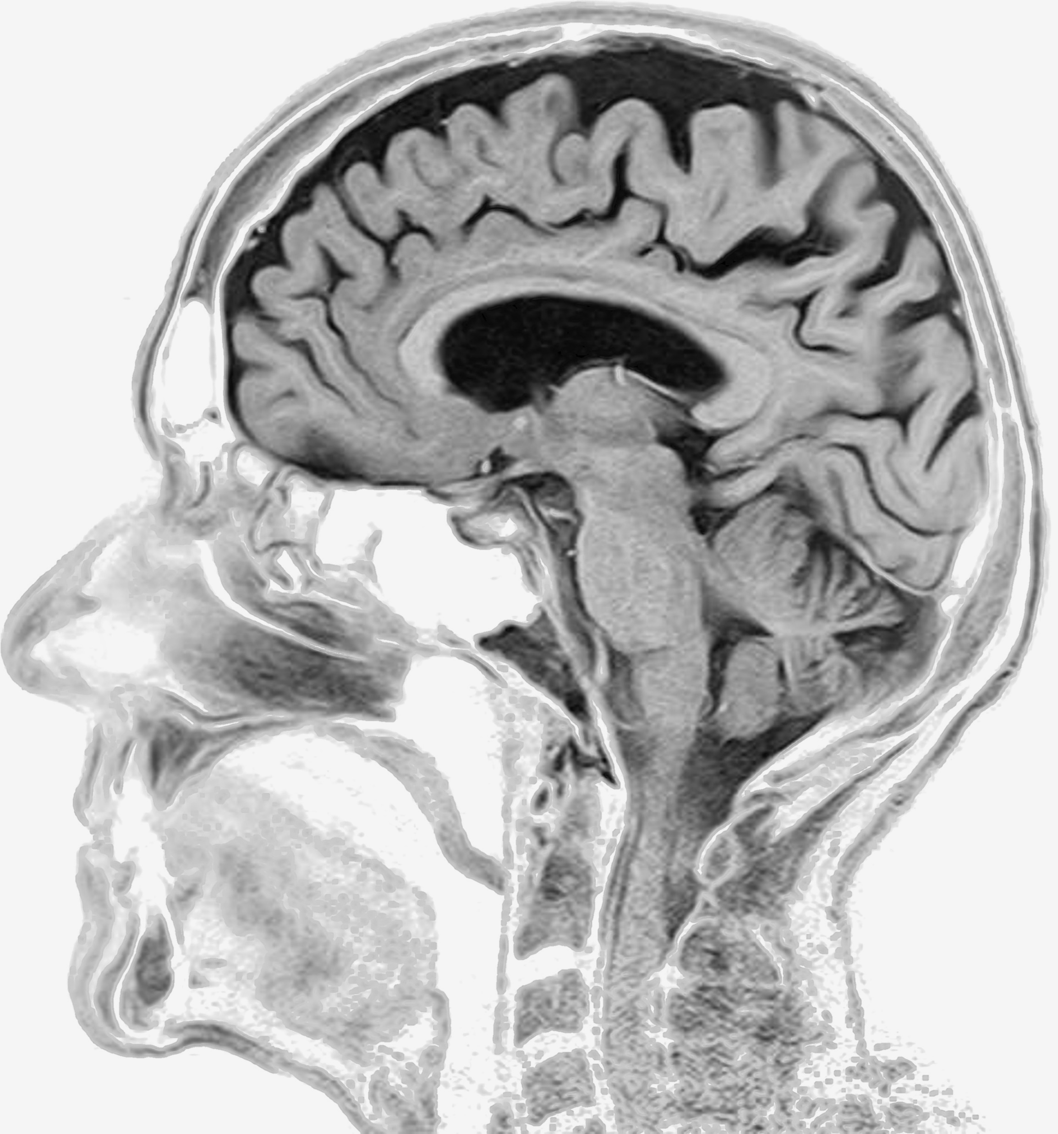
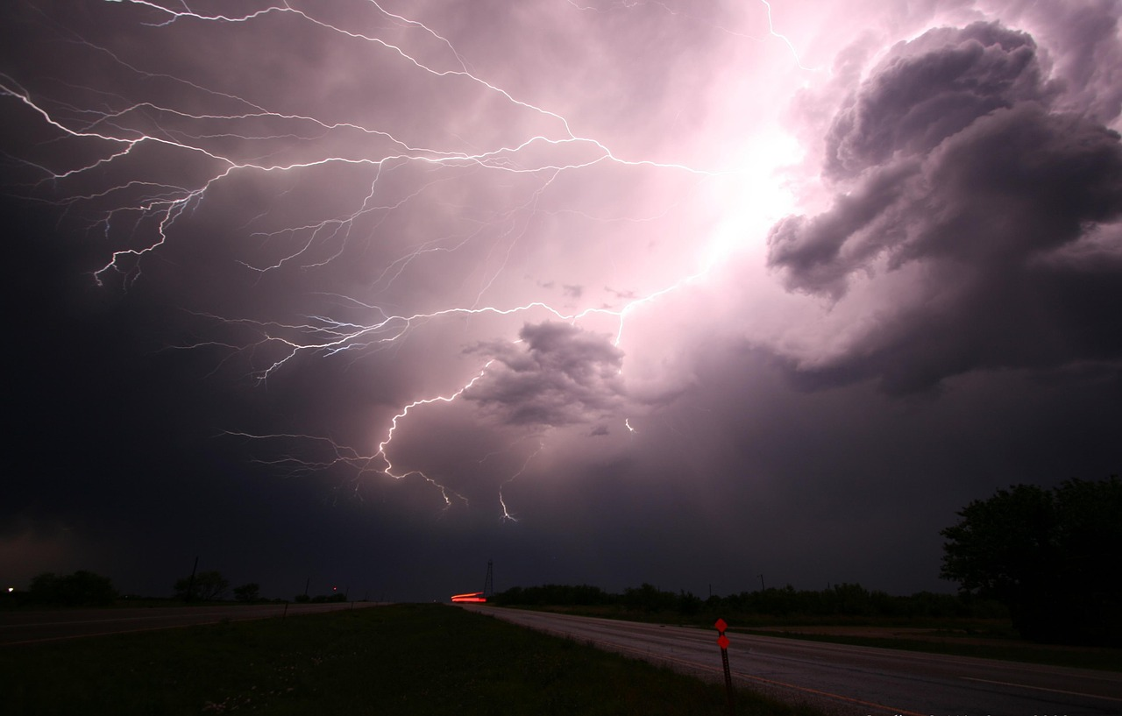

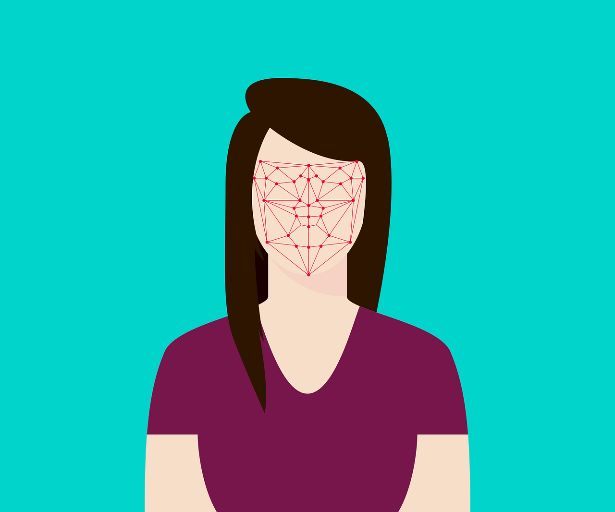
Machine Learning is everywhere…
Searching for rare stars in astronomy data
Identifying regions of disease in medical images
Climate Modelling
Image Credit: SARAO
Voice Recognition
Facial Recognition

Slide 24
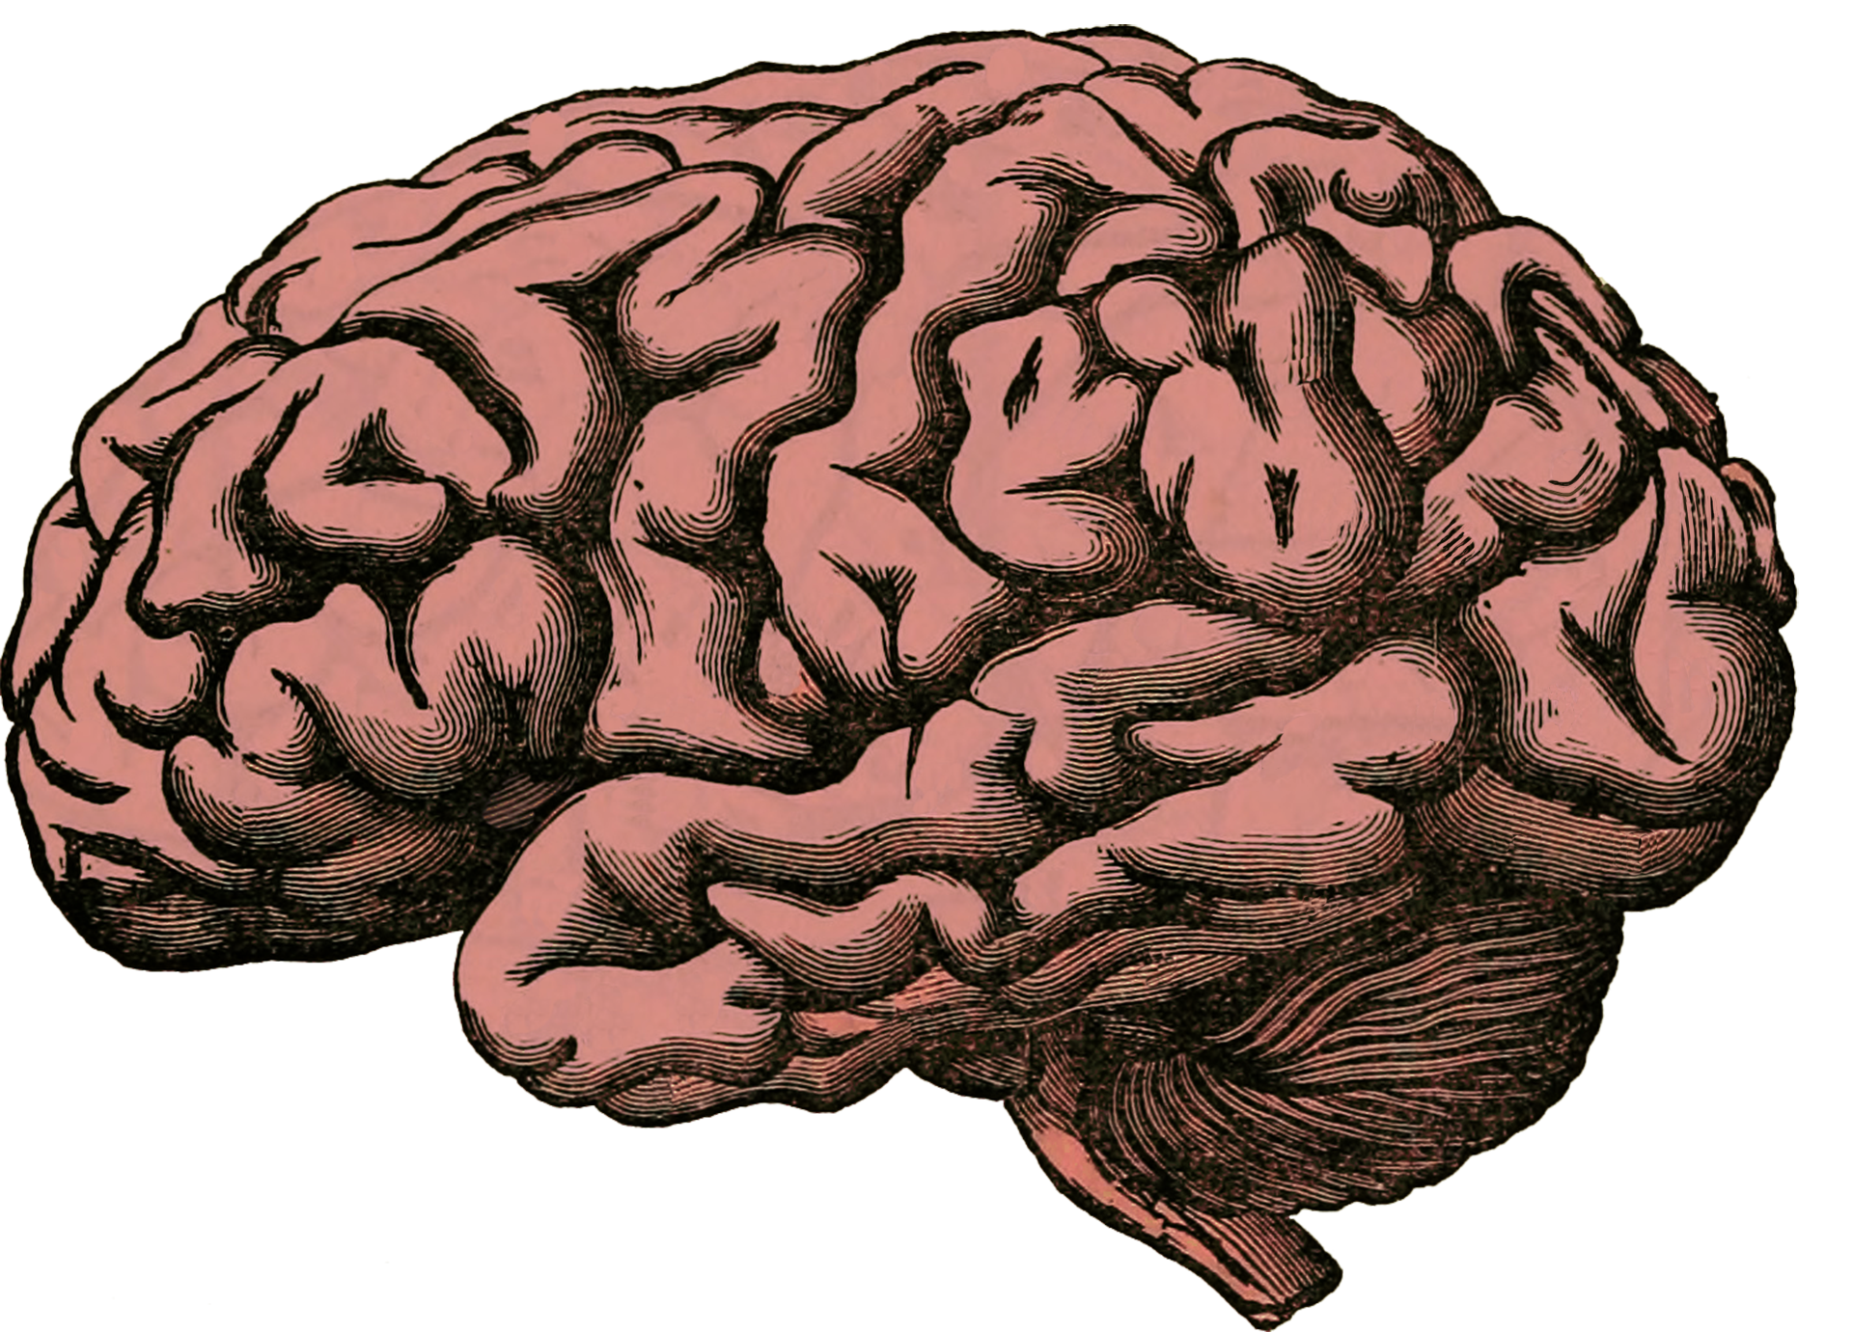
First: human decision making…
Using available information / past experience, we try to make optimal decisions.
Experience is valuable but difficult to quantify.
Actions / Decisions
Data (Sight, sound, taste, touch, smell)

Slide 25
Quantifying Experience…
Experience is describable and quantifiable as data.
You already intuitively understand what data is, but to better understand ML, we must introduce some terminology.
Variables / Attributes / Features
Ground Truth
Mass (Kg) | Height (cm) | Legs | Colour
4.2 | 25.4 | 4 | Black
18 | 43.5 | 4 | Brown
0.1 | 5.1 | 4 | Grey/Black
… | … | … | …
Class / Label
Cat
Dog
Mouse
…
examples
Table 1. Characteristics of animals we’ve seen during our lives.

Slide 26
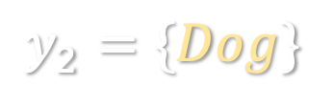
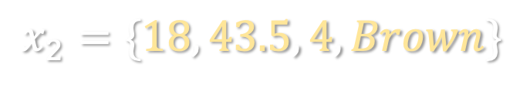
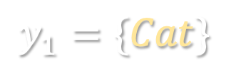
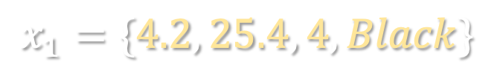
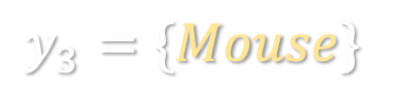
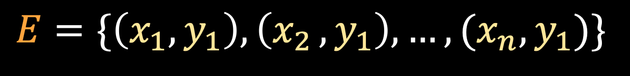
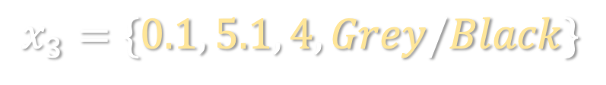
Different Representation
Variables / Attributes / Features
Ground Truth
$$x_{1}=\{4.2, 25.4, 4, Black\}$$
$$y_{1}=\{Cat\}$$
$$x_{2}=\{18, 43.5, 4, Brown\}$$
$$y_{2}=\{Dog\}$$
$$x_{3}=\{0.1, 5.1, 4, Grey/Black\}$$
$$y_{3}=\{Mouse\}$$
$$E=\{\left(x_{1},y_{1}\right),\left(x_{2 }, y_{1}\right), …, (x_{n}, y_{1})\}$$
Experience is comprised of pairs of feature values and ground truth labels.

Slide 27
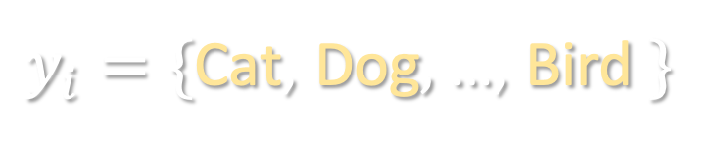
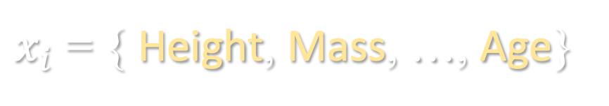
Human Decision Making
Features ( Variables )
$x_{i}$ = { Height, Mass, …, Age}
Labels ( Feedback )
$y_{i}=\{$Cat, Dog$,$…, Bird $\}$
There is a connection between features and labels – labels are obtained as we learn about the world around us.
It’s the same for ML algorithms – they need feedback labels to learn.

Slide 28
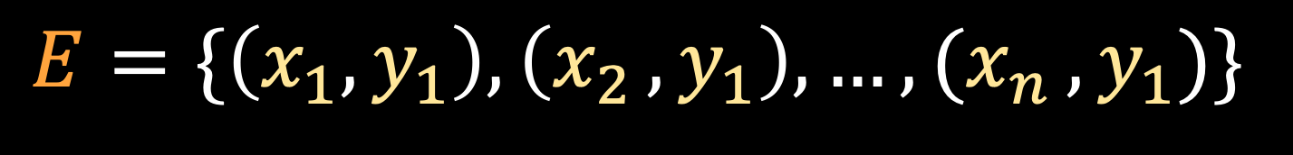
Human Decision Making
Humans are special as we are capable of accurately,
Clustering
Classifying
Predicting
This is only possible via a feedback cycle that allows us to learn.
$$E=\{\left(x_{1},y_{1}\right),\left(x_{2 }, y_{1}\right), …, (x_{n }, y_{1})\}$$
Feedback

Slide 29






Approaches to learning
Supervised
Learning
Semi-supervised
Learning
Unsupervised
Learning
$$?$$
$$?$$
Mammals
Mammals
$$?$$
$$?$$
Birds
$$E$$
$$E$$
$$E$$
Contains labels for mammals & birds, goal is to correctly group unseen animals into mammal & bird classes.
Contains examples labels for mammals only, goal is to correctly group unseen animals into mammal & bird classes.
Contains no labels. Instead we use the data to self describe class separation.
Labeled data
Partially-Labeled data
Unlabeled data

Slide 30


Classification
$$?$$
$$E$$
A process that uses experience to predict labels for never-before-seen examples.
A classification problem is binary if there are two possible labels e.g., mammal vs. bird.
Such classification tasks are everywhere, and we do them every day.
Classification problems in the real-world are often complex, i.e., more than 2 potential classes to predict.
But for the problem were discussing today, we’re dealing with just two classes – pulsar vs. non-pulsar…. A binary problem.
Mammals
Birds
$$?$$
$$E$$
Non
Pulsar
Pulsar

Slide 31
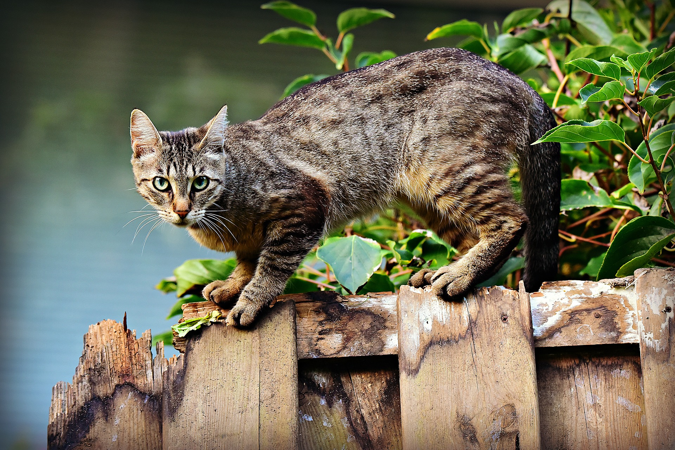
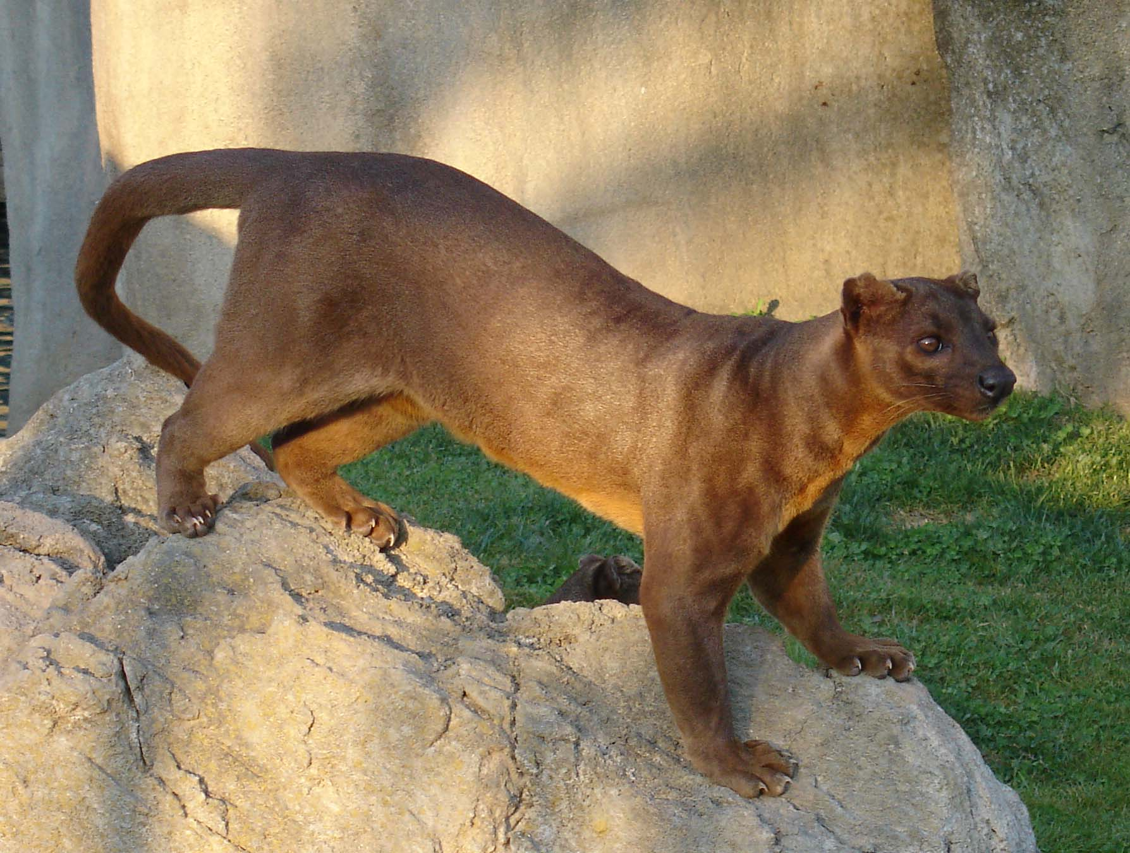
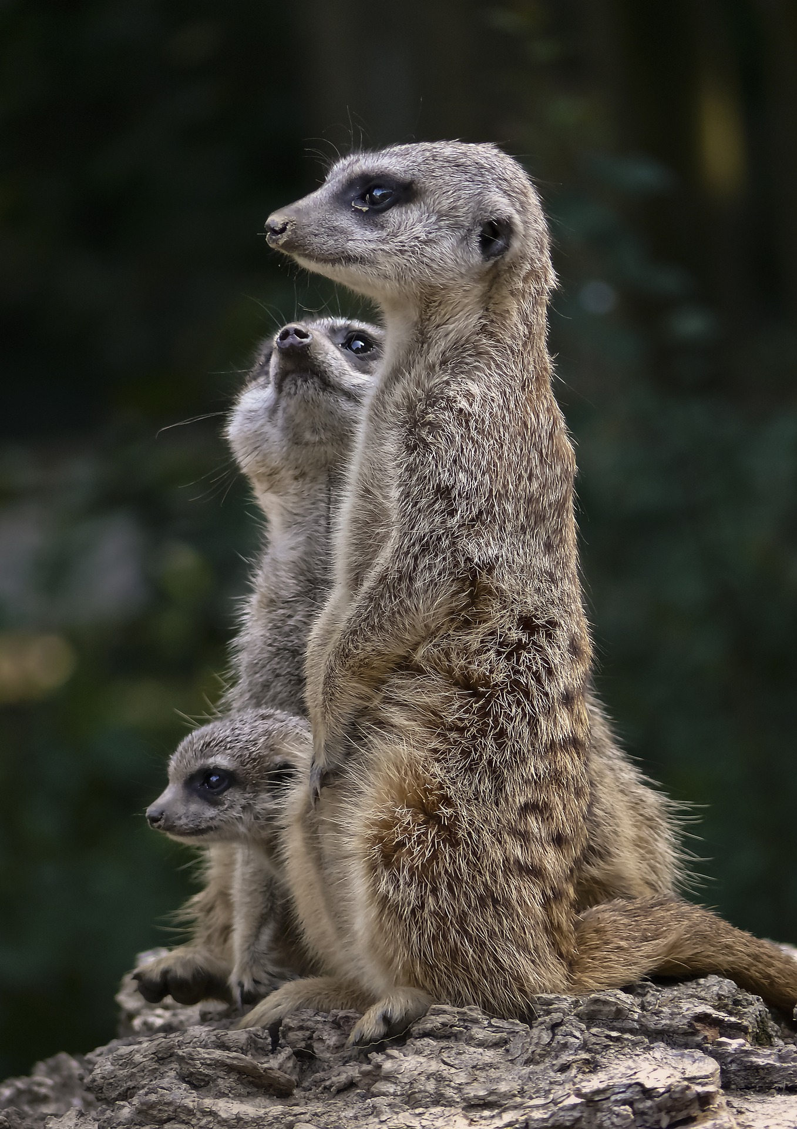
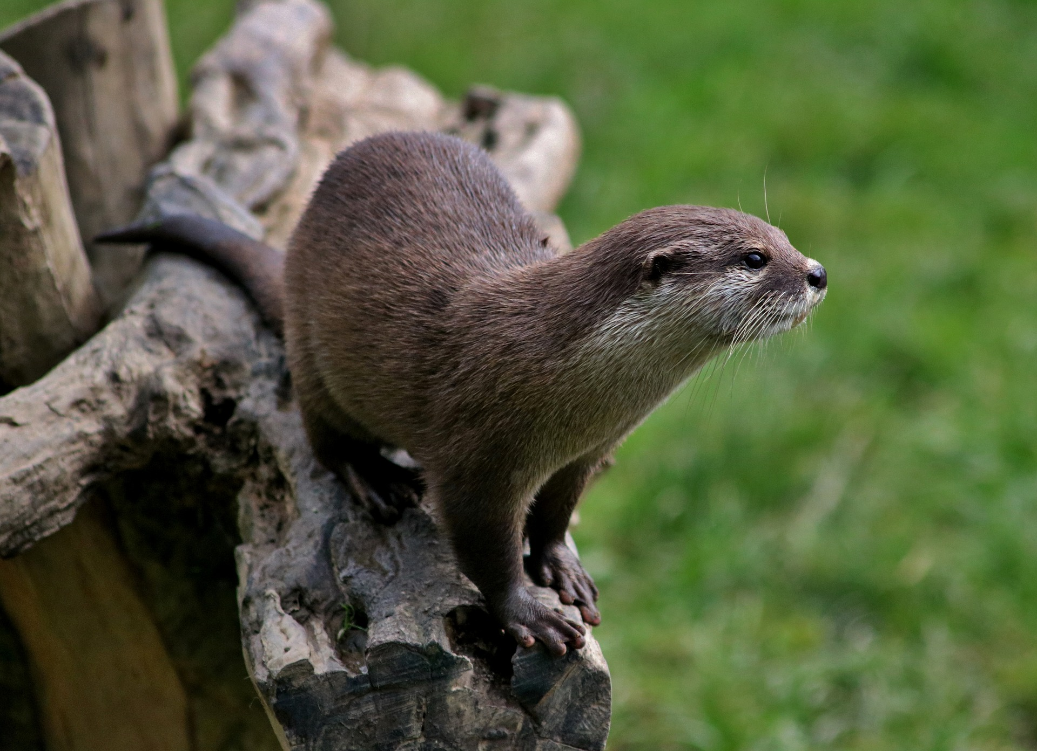
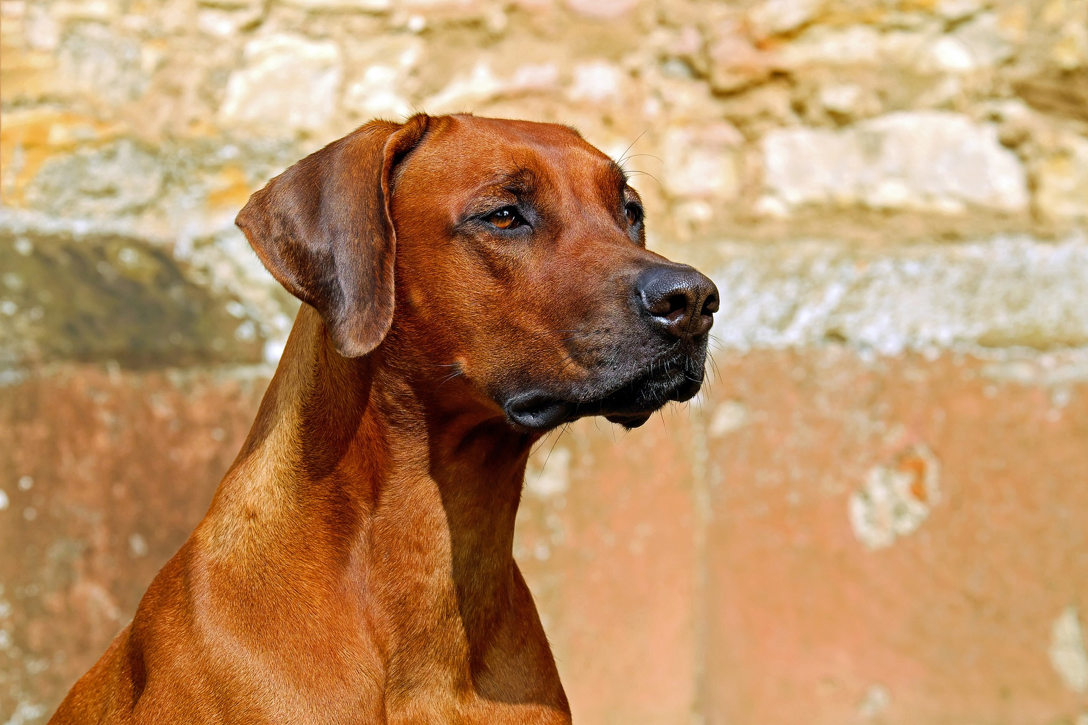
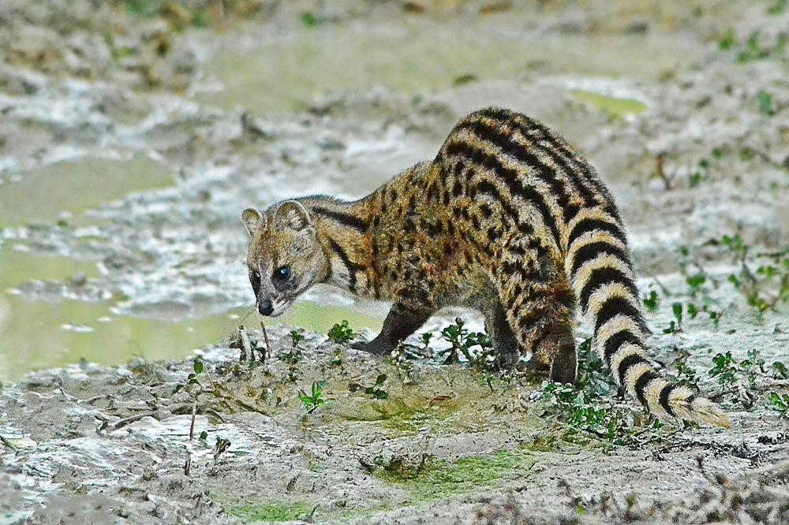

Classification: Example
Feline
Mongoose
$$?$$
Lutrinae
(e.g. Otter)
Viverridae
(e.g Civet)
Canine
Image Credit: Ran Kirlian, CC BY-SA 4.0, https://commons.wikimedia.org/w/index.php?curid=4164754
Uncredited images obtained from https://pixabay.com (Creative Commons License, no attribution required).
Notes:
Let's test your own decision making. There are five animal families summarized on this slide, using the image of their most famous member. There is the Feline family, in the top left image, Lutrinae family in the middle left image (this family includes animals like the Weasel, Otter, and badger relative). The Canine family is in the bottom left image, the Mongoose family in the top right image, and finally the Viverridae family (which includes Civets) in the bottom right image.
The question is this:
Click
Can you tell me which family of creatures this animal is most closely related to? This will only work if you haven’t seen it before….
Is it a,
Canine?
Feline?
Lutrinae?
Viverridae?
Mongoose?
I imagine your currently searching your past experience and looking for features in the image that will tell you what type of animal it is!
Well, this animal is a Fossa. It is a rare animal endemic to Madagascar. It’s most closely related to the Mongoose family, though appears very similar to Felines in most respects. If you answered correctly, then your past experience was sufficient for this task. If not, then your experience was lacking - but now you’ve learned via trial and error, so you’re unlikely to make this mistake again.

Slide 32

How about automated ML then, how's that work?
How does this help us find pulsars?

Slide 33


Automated Learning – trial and error
Suppose we need to be at work, but don’t know the bus schedule. Work starts at 09:00, and the journey takes roughly 40 minutes.
Each day we wait at the bus stop each day, recording some details.
Day | Arrived at bus stop | Bus arrived
Mon | 08:32 | 08:45
Tue | 08:17 | 08:30
Wed | 08:12 | 08:15
Late for work $$y$$
Yes
Yes
No
In this case learning involves finding an arrival time at the bus stop, that lets us make it to work on time.
Each time you’re late, you’ve made an error that you learn from.

Slide 34



How is learning done then?
In ML error is quantified and minimised using the tools of mathematics.
This is done by converting the problem to a mathematical one.
We can reduce finding the best time to wait at the bus stop, to a mathematical problem, i.e., find a value for $t$ that minimizes the number of times you’re late.
Many potential values for $t$work, but clearly it must be 08:15 or earlier!
Day | Arrived at bus stop $$t$$ | Bus arrived
Mon | 08:27 | 08:45
Tue | 08:17 | 08:30
Wed | 08:12 | 08:15
Late for work $$y$$
Yes
Yes
No

Slide 35



Learning Guided by error
Work starts at 09:00.
But takes 40 mins.
There are an infinite number of potential values for $t$.
If we collect data and record enough values for $t$with labels (on time, late), then we could actually create a plot as follows.
This would show us how may errors are made (e.g. how many times were late) for a specific value of $t$.
Clearly then we should choose a $t$ that leads to the fewest errors.
This is basically how automated machine learning works!
Optimal value for $t$
Times late
(Errors)
$$t$$
Too early
Late
08:00
08:15

Slide 36

Giving an Algorithm Experience
The data we collect that an algorithm learns from is called training data.
It represents experience which has been quantified.
If the experience is labelled well, we can train an algorithm to recognise patterns in data.
In the last example, an algorithm would learn to recognise that some values of $t$ made us late.
$$Training data=\{\left(x_{1},y_{1}\right),\left(x_{2 }, y_{1}\right), …, (x_{n}, y_{1})\}$$

Slide 37
What do we need then?
Width
We need a system that can recognise pulsar and non-pulsar candidates.
We need to capture some “experience” of these things that we can give to an algorithm.
Suppose we collect data for some existing pulsars and capture data which is just noise / interference – because we know the origin of these examples, we have labels.
All we need to do next is extract some features from the examples to go with the labels – but which?
Let’s focus on just the pulse profile….
Height
Pulse Profile
P = { 3, 4, 7,..., 2 , 2 , 2}
Pulse height?
Pulse width?
Shape?
Pointedness?
Number of peaks?
…
Notes:
The Crab pulsar has a 33ms period (i.e. rotates 30 times a second).

Slide 38


Learning Features
Profile mean – mean value of the pulse.
We actually extract surprising simple features:
Profile mean.
Profile stdev.
Profile skew.
Profile kurtosis.
These simple features show patterns of difference between pulsar and non-pulsar candidates.
Profile Stdev. – variation in the pulse.
Profile skew – the position of the pulse.
Profile kurtosis – the pointedness.
P = { 3, 4,..., 2 , 2}
Features (Variables)
$x_{i}$ = {$μ$, $σ$, k, s}
Mean
Stdev.
Kurtosis
Labels (Feedback)
$$y_{i}∈\{−1, 0, 1 \}$$
e.g. -1 = non-pulsar etc.
$$Training data=\{\left(x_{1},y_{1}\right),\left(x_{2 }, y_{1}\right), …, (x_{n}, y_{1})\}$$

Slide 39
Some Rationale
Pulsar-like
Noise
RFI / Weak Pulsar?
Profile kurtosis – high, strong point.
Profile kurtosis – high.
Profile kurtosis – low, no points.
Profile mean – medium.
Profile mean – very high.
Profile mean – low, weak signal.
Profile Stdev. – low.
Profile Stdev. – high.
Profile Stdev. – very low.
Profile skew – no skew.
Profile skew – very skewed.
Profile skew – slight skew.
We can use an algorithm to make predictions using feature data like this, that helps us minimise error.
Mean
Stdev.
Kurtosis

Slide 40







Classification Process
$$E$$
Training
Set
= {($x_{1}$, $y_{1}$), …, $(x_{n}\text{,}{ y}_{n})$}
Extract
$$?$$
Learn / Evaluate
Features
Predict
$x_{i}$ = {$μ$, $σ$, k, s}
Input
Data
Labels
= {($x_{1}$), …, $(x_{n})$}
$$y_{i}∈\{−1, 0, 1 \}$$
Features
Extract
$x_{i}$ = {$μ$, $σ$, k, s}
Predictions
= {($x_{1}$, $y_{1}$), …, $(x_{n}\text{,} y_{n})$}

Slide 41








Example Learning Algorithm: Decision Stump
$$μ$$
Phi
$$φ$$
if mean $≤$ $φ$
if mean $>$ $φ$
if mean $≤ φ$
if mean $>$ $φ$
Predict
Pulsar
Predict
Non-Pulsar
Predict Pulsar
Predict
Non-pulsar
Mean of this
The decision stump is a simple ML algorithm that classifies data by splitting it into two.
It splits data on a single-feature that minimises the error.
It is a linear separator, or a linear model.
It produces a linear separator between two classes – we can visualise this.
We know how to train this – search for a value for $φ$ that minimises the number of errors!
Mean of profile ($μ$)

Slide 42







Decision Stump
For each feature in the data, the stump will search for a split-point, that minimises the error rate.
In our example we used $μ$ as a feature, and our threshold = $φ$.
$$μ$$
$$φ$$
if mean $≤$ $φ$
if mean $>$ $φ$
Mistakes
made
Predict Pulsar
Predict
Non-pulsar
$$0$$
$$μ$$

Slide 43
Combining Stumps: Decision Tree
Suppose we have the dataset below plotted in some 2D space.
Our goal is the separate pulsar and non-pulsar as accurately as possible.
For complex data like this, we could use a decision tree.
I could combine multiple stumps to do this. Here’s how…
Successively discriminates into classes by partitioning the data.
Each partition forms an extra decision boundary.
This approach can build complex boundaries over the data.
Using just a few stumps – I’m able to accurately separate data.
An algorithm that works this way is called a decision tree.
Key question – which feature to split on at any given time?
4.
Pure
2.
3.
1.
6.
1/1
4/4
5.

Slide 44


Decision Tree Split Choice
At each spilt point, find the feature that maximizes the separation between each class is chosen.
Done by considering the statistical distribution of the features.
Via an optimization method (search over all the possible split-points, find the best).
We can build arbitrarily deep decision trees to classify our data.
If profile symmetric
If profile is pointy
If profile mean is low
If $μ≤$ $φ$
If not symmetric
If profile isn’t pointy
If $μ>$ $φ$
If profile mean is high

Slide 45


Other Approaches
There are many other algorithms that we use to classify pulsar data.
Neural networks, Random Forests, Ensemble Algorithms…
Too much to explain in a single masterclass!
Real
Interference
Credit: Zafiirah Hosenie
VGG16 Architecture

Slide 46


Discoveries
Very slow spinning pulsar... Spins once every 21 seconds.
Credit: LOTAAS Collaboration (Chia Min Tan et. al.).
We’ve made many other discoveries too with these tools.

Slide 47

Masterclass Resources..
How to get them, what they contain…
https://apod.nasa.gov/apod/ap190708.html

Slide 48
Software Development Environment
To search for pulsars we need to develop code. We need tools for this…
A tool we can use to write code – a little like using Microsoft Word to write essays.
A tool that converts the code files we write, into machine code.
A tool that allows us to run the machine code.
We don’t have the time to setup our own environments – instead, we’re going to use a pre-built, on-line development environment that allows us to write Python code.
This tool is called Google Collaboratory.

Slide 49



Google Collaboratory
Google Collaboratory has it’s own code editor, and tools that can be used to run code.
You connect to this via the Google Chrome web browser.
You may be interested to know that Google Collaboratory is a cloud environment.
It is also a great environment for newcomers!
Language Tools
External Libraries
Tools (Code Editors)

Slide 50

Step 1.
Connect to the Google Collaboratory.
You need:
A google account.
The google Chrome web-browser installed.
Instructions are in the notebook provided.

Slide 51

Accessing the Collaboratory
Firstly open google Chrome – if you don’t have Chrome, you’ll need to install it via: https://www.google.com/intl/en_uk/chrome/ .
Create a Google account if you don’t have one, then sign-in to the Collaboratory environment via: https://colab.research.google.com/ .
Once everyone is signed in, you should see a user interface that looks a little like this:
Notes:
Google Chrome install link: https://www.google.com/intl/en_uk/chrome/
Google Collaboratory link: https://colab.research.google.com/notebooks/intro.ipynb

Slide 52

Step 2.
Loading the notebook.
You need:
The notebook can be found online via Github:
https://github.com/scienceguyrob/AI4AstroMasterclass
The GitHub site.

Slide 53


Understanding the notebook
A notebook is a coding environment within the Collaboratory.
It’s actually a special environment, because it allows you to write code or normal text within it.
The notebook itself is represented within a single file – stored in the cloud (in Google Drive).
Notebook files end with the .ipynb file extension.
Creating a new notebook – click File -> New Notebook.
Notes:
Google Chrome install link: https://www.google.com/intl/en_uk/chrome/
Google Collaboratory link: https://colab.research.google.com/notebooks/intro.ipynb

Slide 54

Step 3.
Work through the notebook at your own pace.
There’s a huge amount of material there – you won’t get through it quickly.
It’s meant to be used slowly for those who are really interested!
Everything you need – data, plots etc. is in the notebook.
The notebook.

Slide 55
Notebook Data
The notebook contains real data I obtained.
It consists of pulse profiles for 1,586 pulsar and 8,852 non-pulsar examples.
The data was labelled by me, so it is correct (obvs!).
Each profile has exactly 128 data points (an array of 128 values).
The data also contains noise examples, along with strong and weak forms of interference.
This pulsar data is very imbalanced in favour of the non-pulsars.
It’s your job to use this data to train and deploy a classifier!
This is pulse profile data.
P = [ 23, 34, …, 24, 12]
The data can be represented in an array / list.

Slide 56
Final Thoughts
I hope you found the masterclass interesting – it is a fascinating area IMO.
The truth is, there are many discoveries that wouldn’t have been made if computer scientists weren't involved.
Computer science permeates every subject area and is becoming increasingly important over time.
Computing technology and big data drives everything – you can play a role by using both to make a difference.
Maybe you’re not as interested in astronomy as me - but there are other fields: medicine, finance, chemistry, materials science, control systems, robotics, …
There are many options and opportunities – don’t limit yourselves and aim to do something you enjoy!
Here’s why I enjoy the work I do…

Slide 57



Questions & Thank For Listening
@scienceguyrob
lyonro@edgehill.ac.uk
Acknowledgements
Uncredited images obtained from https://pixabay.com (Creative Commons License, no attribution required).
More Information:
https://github.com/scienceguyrob/AI4AstroMasterclass
Notes:
60 seconds - 7 minutes 30 seconds

